Slide 1
Design & Analysis of Algorithms
Lecture 3

Slide 2
Recursion Tree Method
Recursion Tree is another method for solving recurrence relations. This method work on two steps. These are
First, A set of pre level costs are obtained by sum the cost of each level of the tree.
Second, to determine the total cost of all level of recursion, we sum all the pre level cost.
This method is best used for good guess.
For generating good guess, we can ignore floors and ceiling when solving the recurrences. Because, they usually do not affect the final guess.

Slide 3
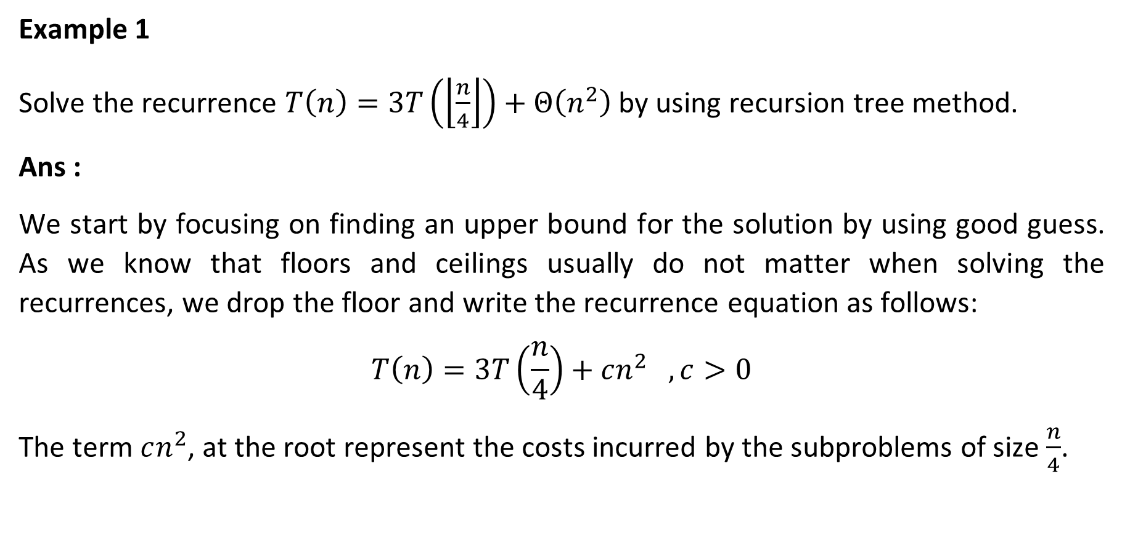
Recursion Tree Method (Example 1)
Example 1
Solve the recurrence $T\left(n\right)=3T\left(\left\lfloor \frac{n}{4}\right\rfloor \right)+Θ\left(n^{2}\right)$ by using recursion tree method.
Ans :
We start by focusing on finding an upper bound for the solution by using good guess. As we know that floors and ceilings usually do not matter when solving the recurrences, we drop the floor and write the recurrence equation as follows:
$$T\left(n\right)=3T\left(\frac{n}{4}\right)+cn^{2} , c>0$$
The term $cn^{2}$, at the root represent the costs incurred by the subproblems of size $\frac{n}{4}$.

Slide 4
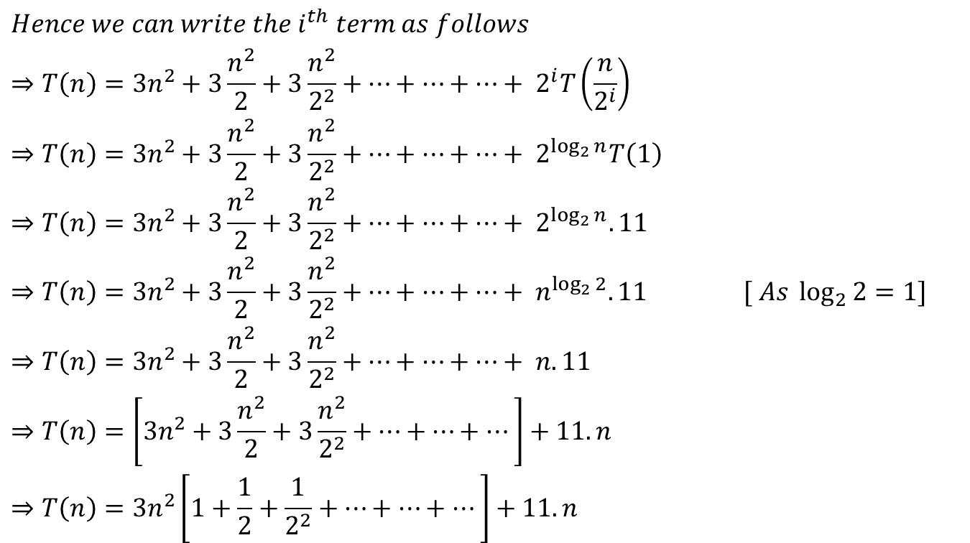

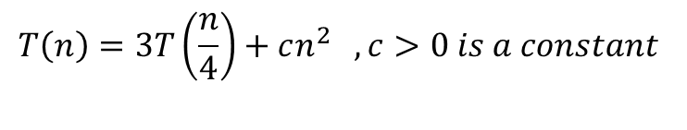
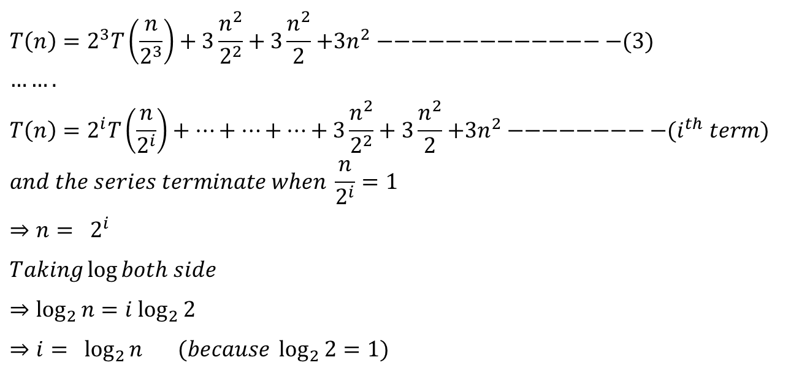
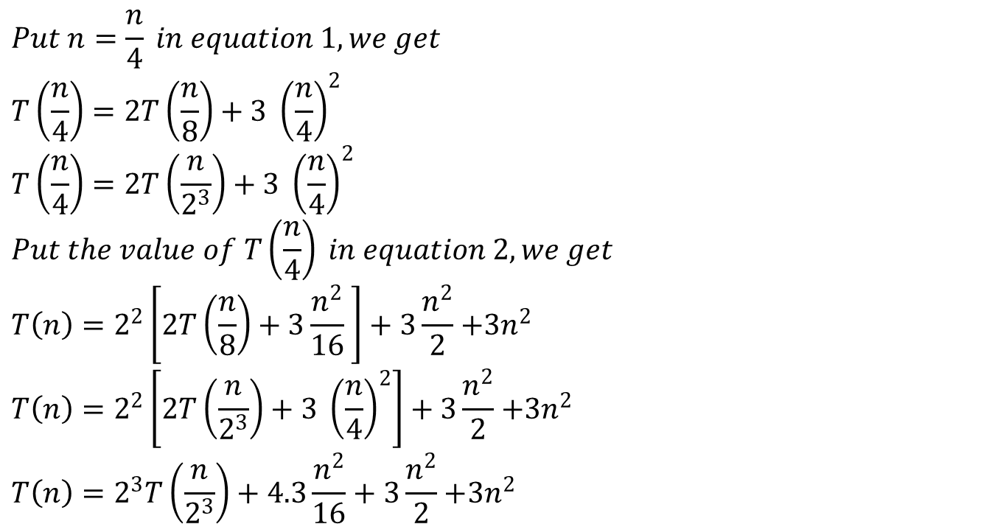
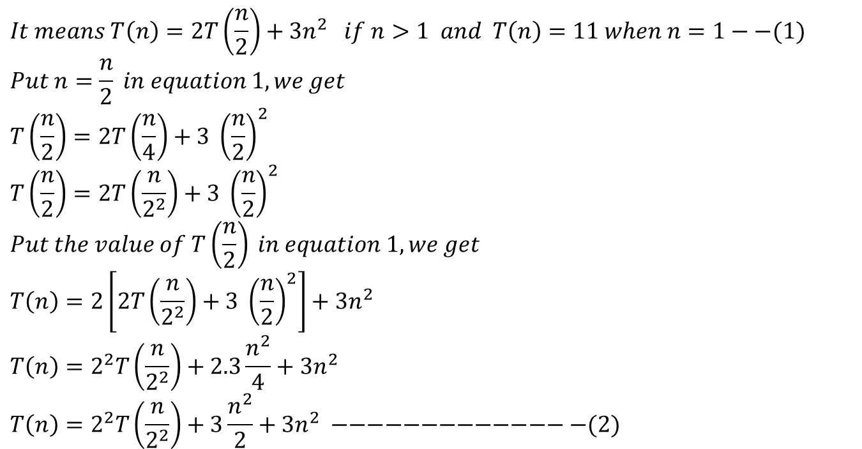
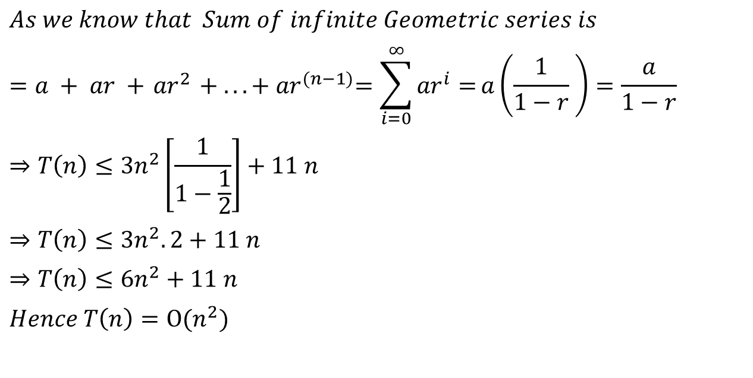
Recursion Tree Method (Example 1)
$$T\left(n\right)=3T\left(\frac{n}{4}\right)+cn^{2} , c>0 is a constant$$
$$T(n)$$
Fig –(a)
Figure (a) shows T(n), which progressively expands in (b) and (d) to form recursion tree.
$$c{\left(n\right)}^{2}$$
$$T\left(\frac{n}{4}\right)$$
$$T\left(\frac{n}{4}\right)$$
$$T\left(\frac{n}{4}\right)$$
Fig –(b)

Slide 5
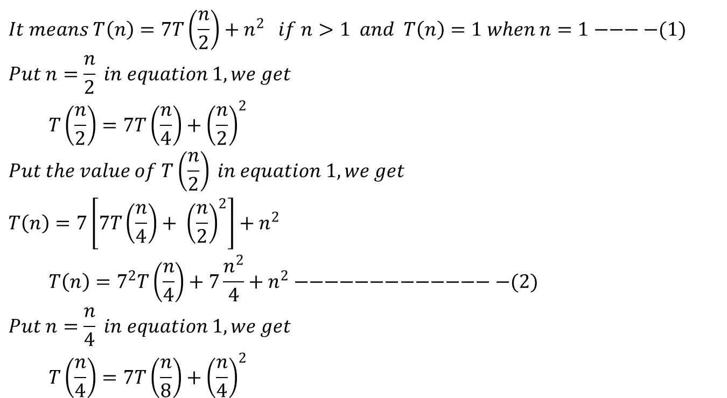

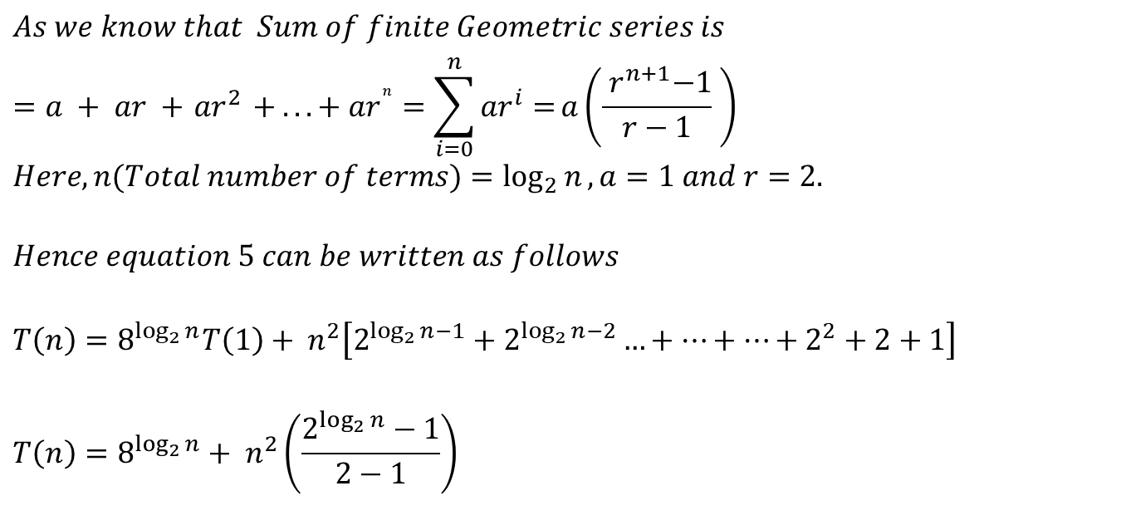

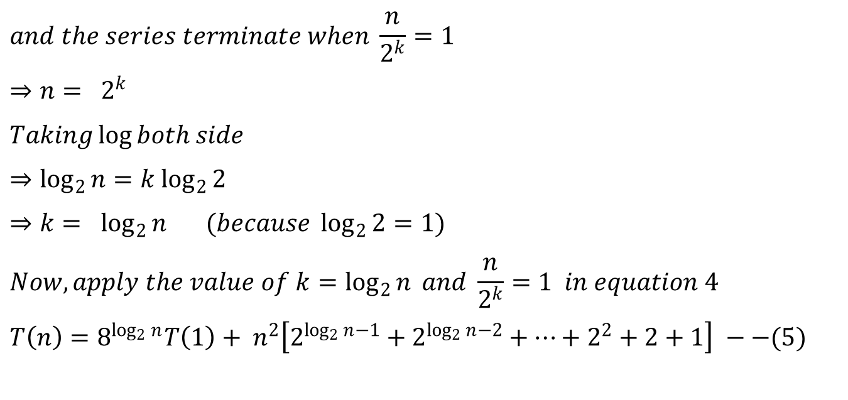
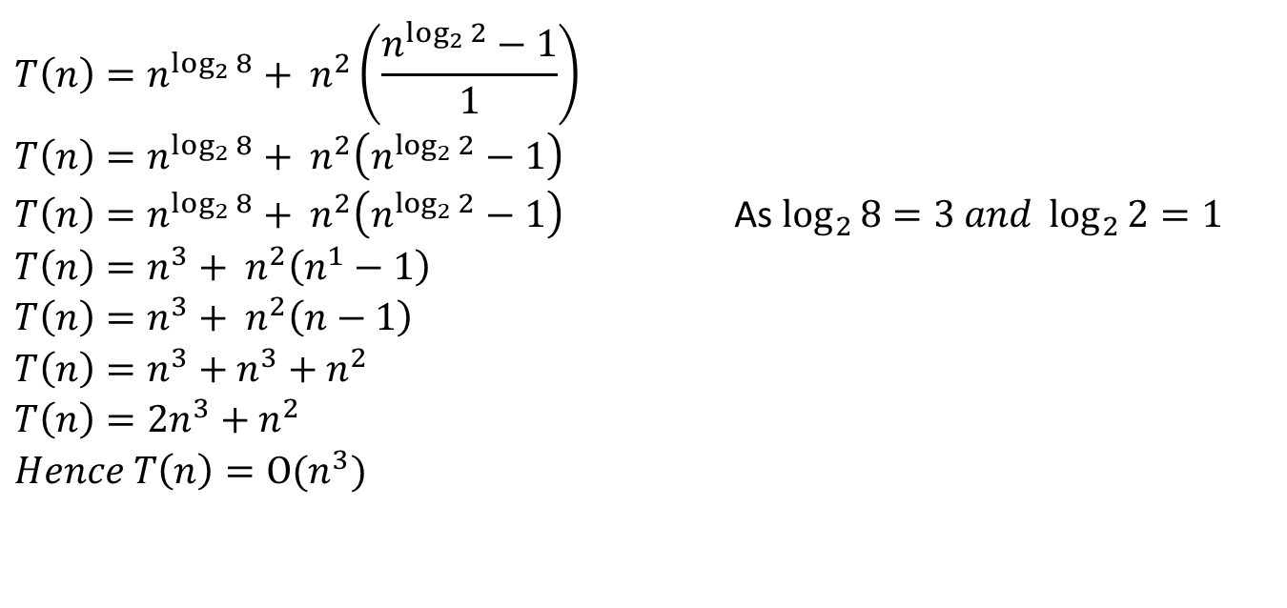
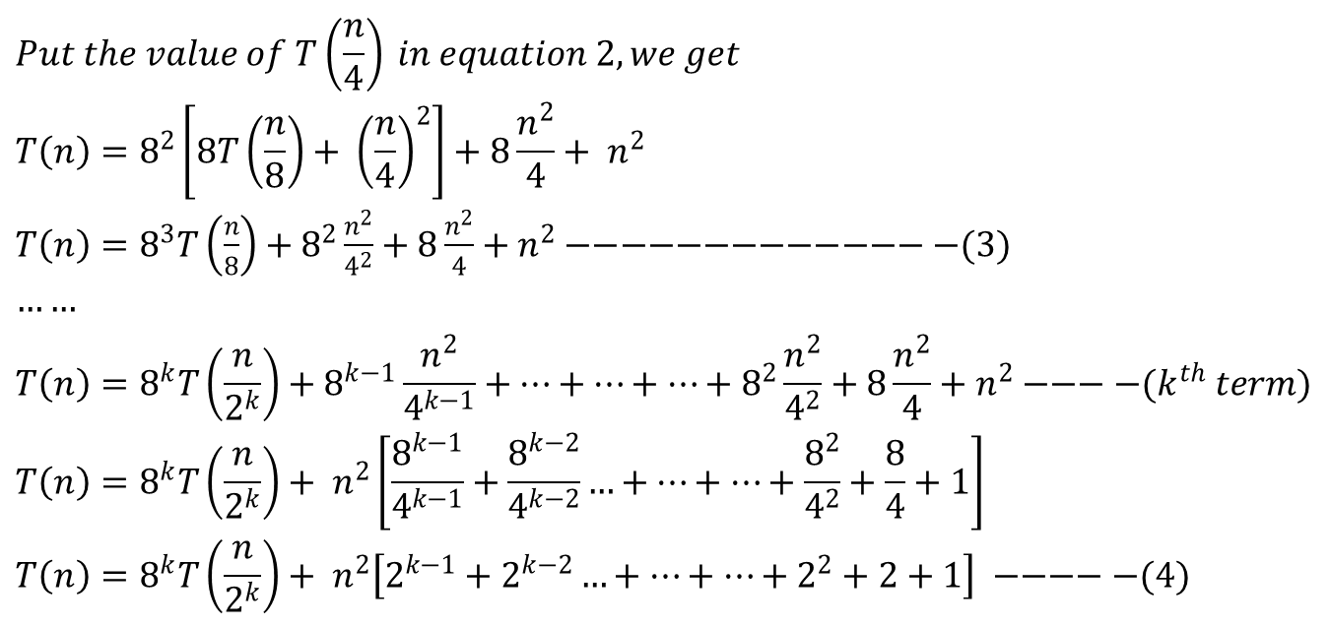
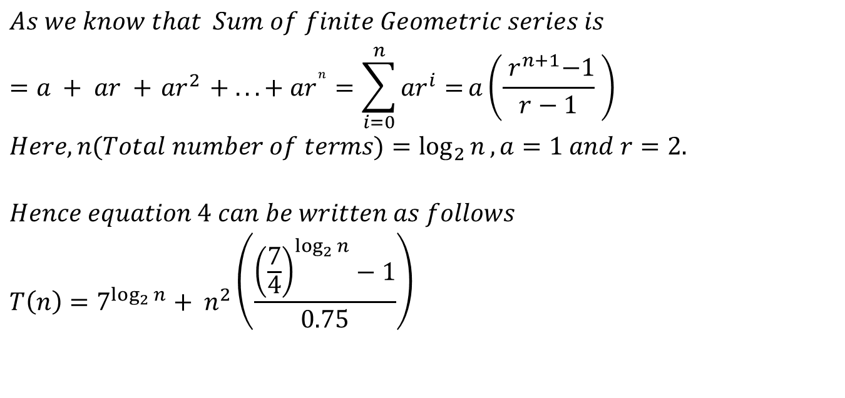
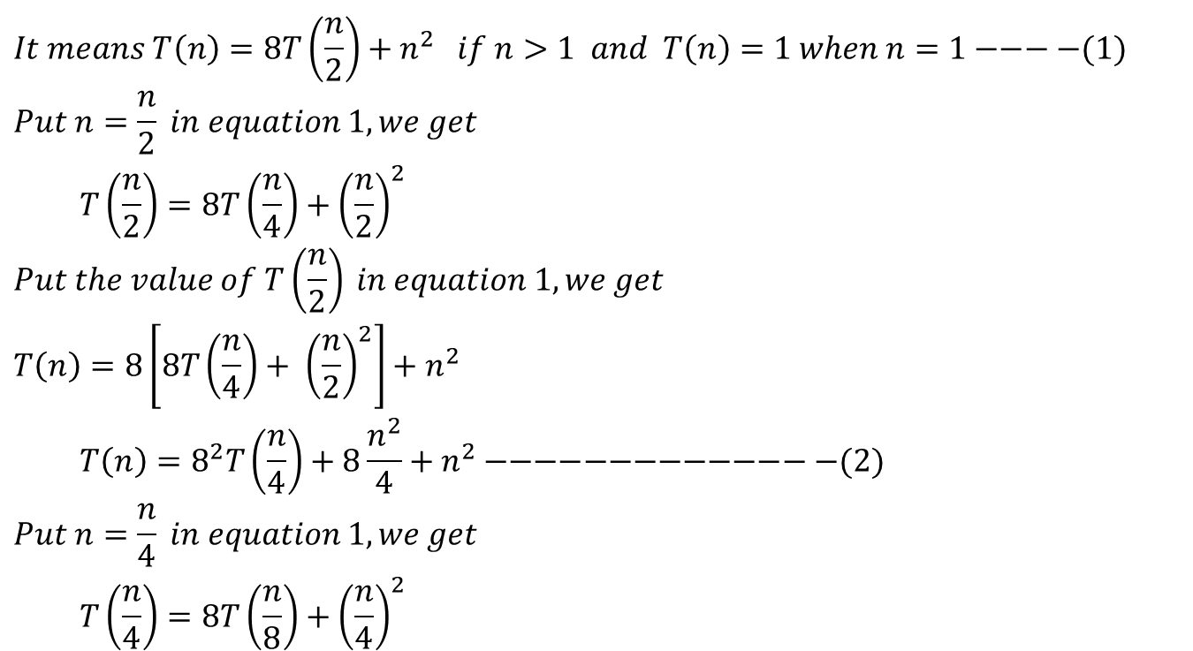
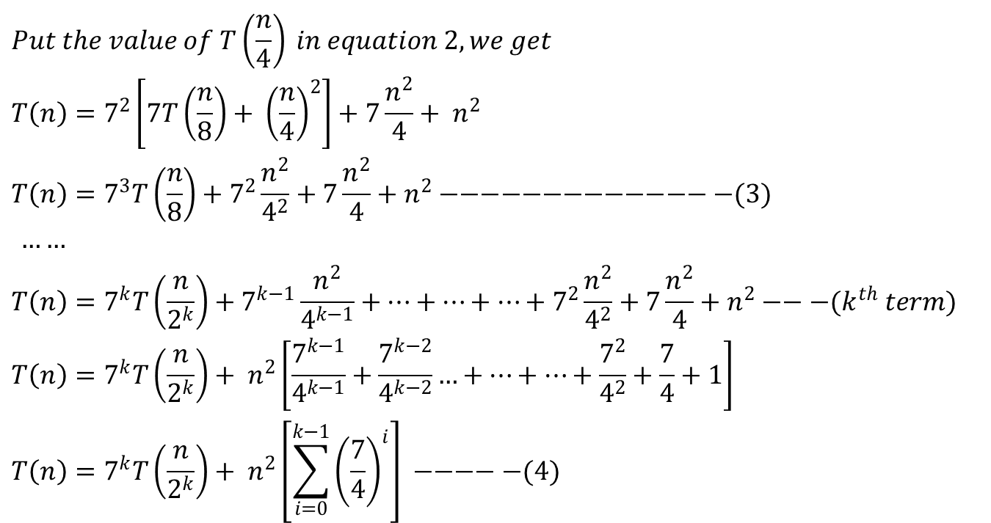
Recursion Tree Method (Example 1)
$$T\left(n\right)=3T\left(\frac{n}{4}\right)+cn^{2} , c>0 is a constant$$
$$c{\left(n\right)}^{2}$$
$$c{(n/4)}^{2}$$
$$c{(n/4)}^{2}$$
$$c{(n/4)}^{2}$$
$$T\left(\frac{n}{16}\right)$$
$$T\left(\frac{n}{16}\right)$$
$$T\left(\frac{n}{16}\right)$$
$$T\left(\frac{n}{16}\right)$$
$$T\left(\frac{n}{16}\right)$$
$$T\left(\frac{n}{16}\right)$$
$$T\left(\frac{n}{16}\right)$$
$$T\left(\frac{n}{16}\right)$$
$$T\left(\frac{n}{16}\right)$$
Fig –(c)

Slide 6



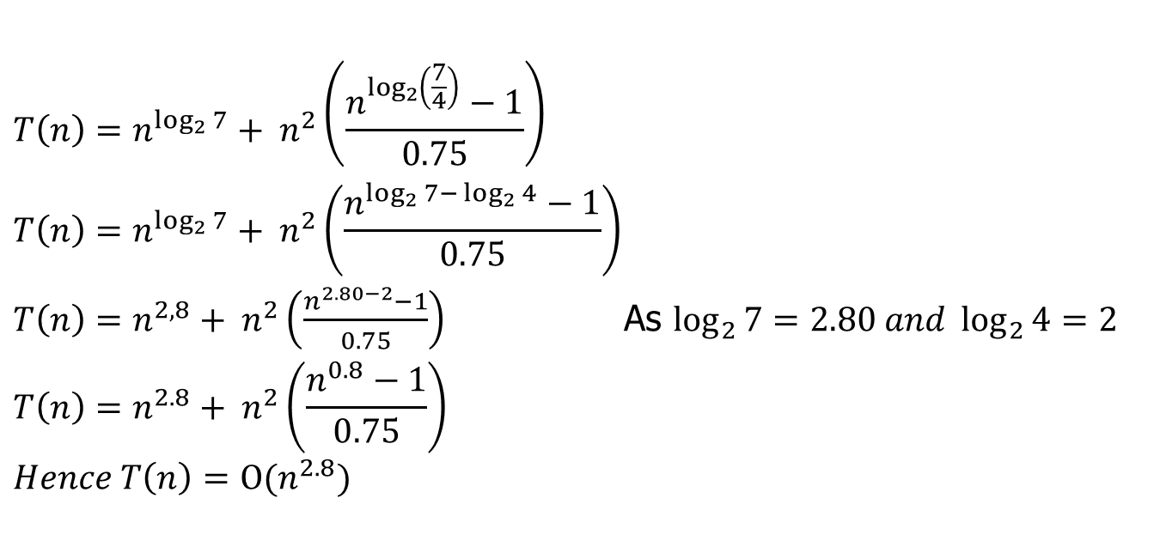

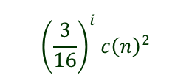




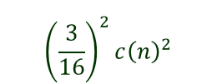










Recursion Tree Method (Example 1)
$$T\left(n\right)=3T\left(\frac{n}{4}\right)+cn^{2} , c>0 is a constant$$
$$c{\left(n\right)}^{2}$$
$$c{\left(n\right)}^{2}$$
$$\frac{3}{16}c{\left(n\right)}^{2}$$
$$c{(n/4)}^{2}$$
$$c{(n/4)}^{2}$$
$$c{(n/4)}^{2}$$
$$\log_{4}{n}$$
$${\left(\frac{3}{16}\right)}^{2}c{\left(n\right)}^{2}$$
$$c{\left(\frac{n}{16}\right)}^{2}$$
$$c{\left(\frac{n}{16}\right)}^{2}$$
$$c{\left(\frac{n}{16}\right)}^{2}$$
$$c{\left(\frac{n}{16}\right)}^{2}$$
$$c{\left(\frac{n}{16}\right)}^{2}$$
$$c{\left(\frac{n}{16}\right)}^{2}$$
$$c{\left(\frac{n}{16}\right)}^{2}$$
$$c{\left(\frac{n}{16}\right)}^{2}$$
$$c{\left(\frac{n}{16}\right)}^{2}$$
$${\left(\frac{3}{16}\right)}^{i}c{\left(n\right)}^{2}$$
$$T\left(1\right) T\left(1\right) T\left(1\right)………………………..T\left(1\right)$$
$${\left(3\right)}^{i}$$
Fig –(d)

Slide 7
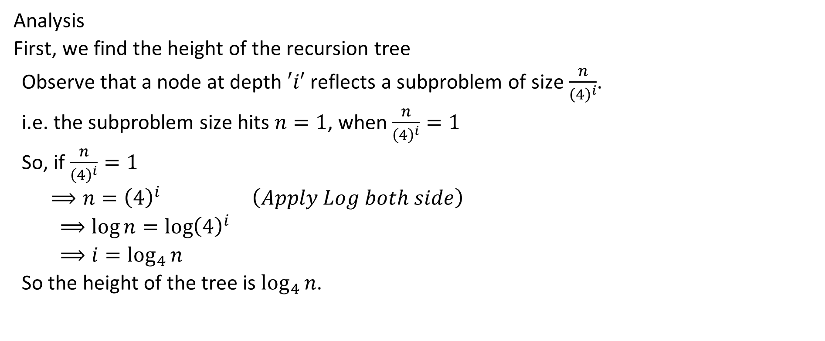
Recursion Tree Method (Example 1)
Analysis
First, we find the height of the recursion tree
Observe that a node at depth $′i′$ reflects a subproblem of size $\frac{n}{{\left(4\right)}^{i}}$.
i.e. the subproblem size hits $n=1$, when $\frac{n}{{\left(4\right)}^{i}}=1$
So, if $\frac{n}{{\left(4\right)}^{i}}=1$
$⟹n={\left(4\right)}^{i} \left(Apply Log both side\right)$
$$⟹\log{n=\log{{\left(4\right)}^{i}}}$$
$$⟹i=\log_{4}{n}$$
So the height of the tree is $\log_{4}{n}$.

Slide 8
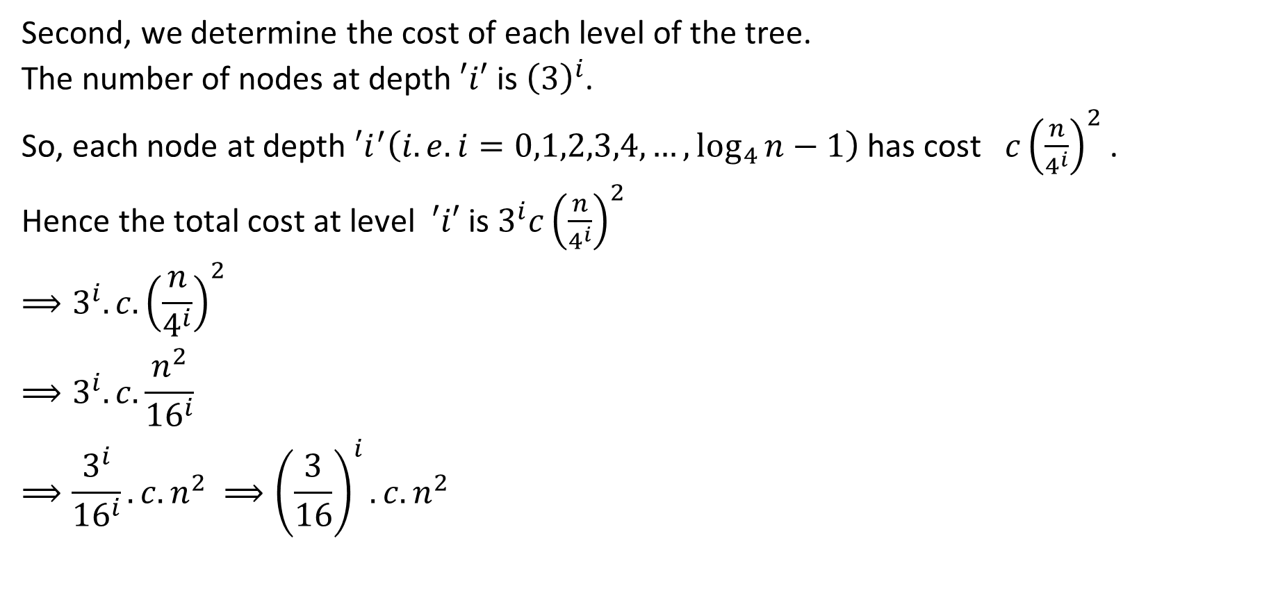
Recursion Tree Method (Example 1)
Second, we determine the cost of each level of the tree.
The number of nodes at depth $′i′$ is ${\left(3\right)}^{i}$.
So, each node at depth $′i^{′}\left(i.e. i=0,1,2,3,4,…, \log_{4}{n}−1\right)$ has cost $c{\left(\frac{n}{4^{i}}\right)}^{2}$ .
Hence the total cost at level $′i′$ is $3^{i}c{\left(\frac{n}{4^{i}}\right)}^{2}$
$$⟹3^{i}. c.{\left(\frac{n}{4^{i}}\right)}^{2}$$
$$⟹3^{i}. c.\frac{n^{2}}{{16}^{i}}$$
$$⟹\frac{3^{i}}{{16}^{i}}. c.n^{2} ⟹{\left(\frac{3}{16}\right)}^{i}.c.n^{2}$$

Slide 9
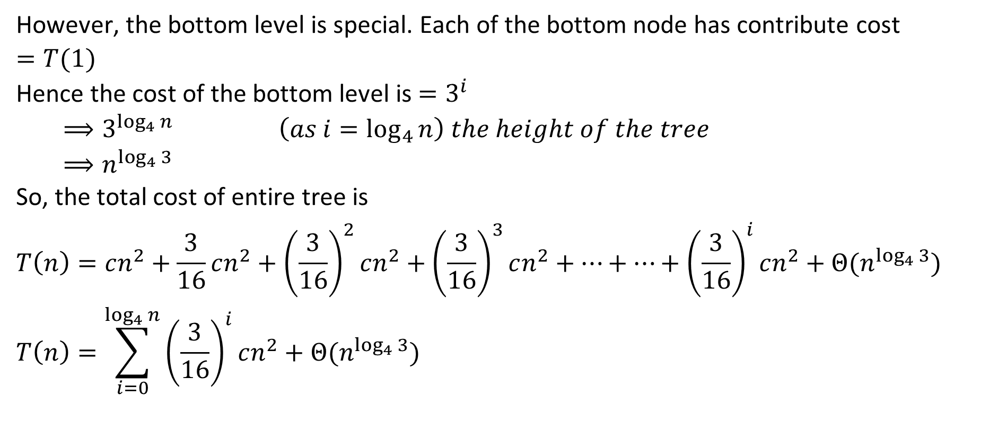
Recursion Tree Method (Example 1)
However, the bottom level is special. Each of the bottom node has contribute cost $=T(1)$
Hence the cost of the bottom level is $=3^{i}$
$$⟹3^{\log_{4}{n}} \left(as i=\log_{4}{n}\right) the height of the tree$$
$$⟹n^{\log_{4}{3}}$$
So, the total cost of entire tree is
$$T\left(n\right)=cn^{2}+\frac{3}{16}cn^{2}+{\left(\frac{3}{16}\right)}^{2}cn^{2}+{\left(\frac{3}{16}\right)}^{3}cn^{2}+…+…+{\left(\frac{3}{16}\right)}^{i}cn^{2}+Θ(n^{\log_{4}{3}})$$
$$T\left(n\right)=\sum_{i=0}^{\log_{4}{n}}{{\left(\frac{3}{16}\right)}^{i}cn^{2}}+Θ(n^{\log_{4}{3}})$$

Slide 10
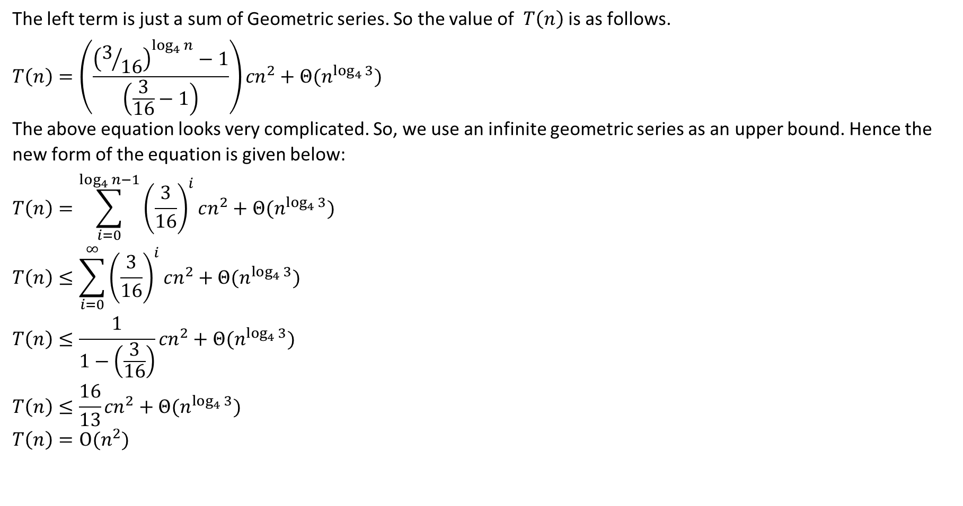
Recursion Tree Method (Example 1)
The left term is just a sum of Geometric series. So the value of $T\left(n\right)$ is as follows.
$$T\left(n\right)=\left(\frac{{\left(3/{16}\right)}^{\log_{4}{n}}−1}{\left(\frac{3}{16}−1\right)}\right){cn}^{2}+Θ(n^{\log_{4}{3}})$$
The above equation looks very complicated. So, we use an infinite geometric series as an upper bound. Hence the new form of the equation is given below:
$$T\left(n\right)=\sum_{i=0}^{\log_{4}{n−1}}{{\left(\frac{3}{16}\right)}^{i}cn^{2}}+Θ(n^{\log_{4}{3}})$$
$$T\left(n\right)≤\sum_{i=0}^{∞}{{\left(\frac{3}{16}\right)}^{i}cn^{2}}+Θ(n^{\log_{4}{3}})$$
$$T\left(n\right)≤\frac{1}{1−\left(\frac{3}{16}\right)}{cn}^{2}+Θ(n^{\log_{4}{3}})$$
$$T\left(n\right)≤\frac{16}{13}{cn}^{2}+Θ(n^{\log_{4}{3}})$$
$$T\left(n\right)=Ο(n^{2})$$

Slide 11
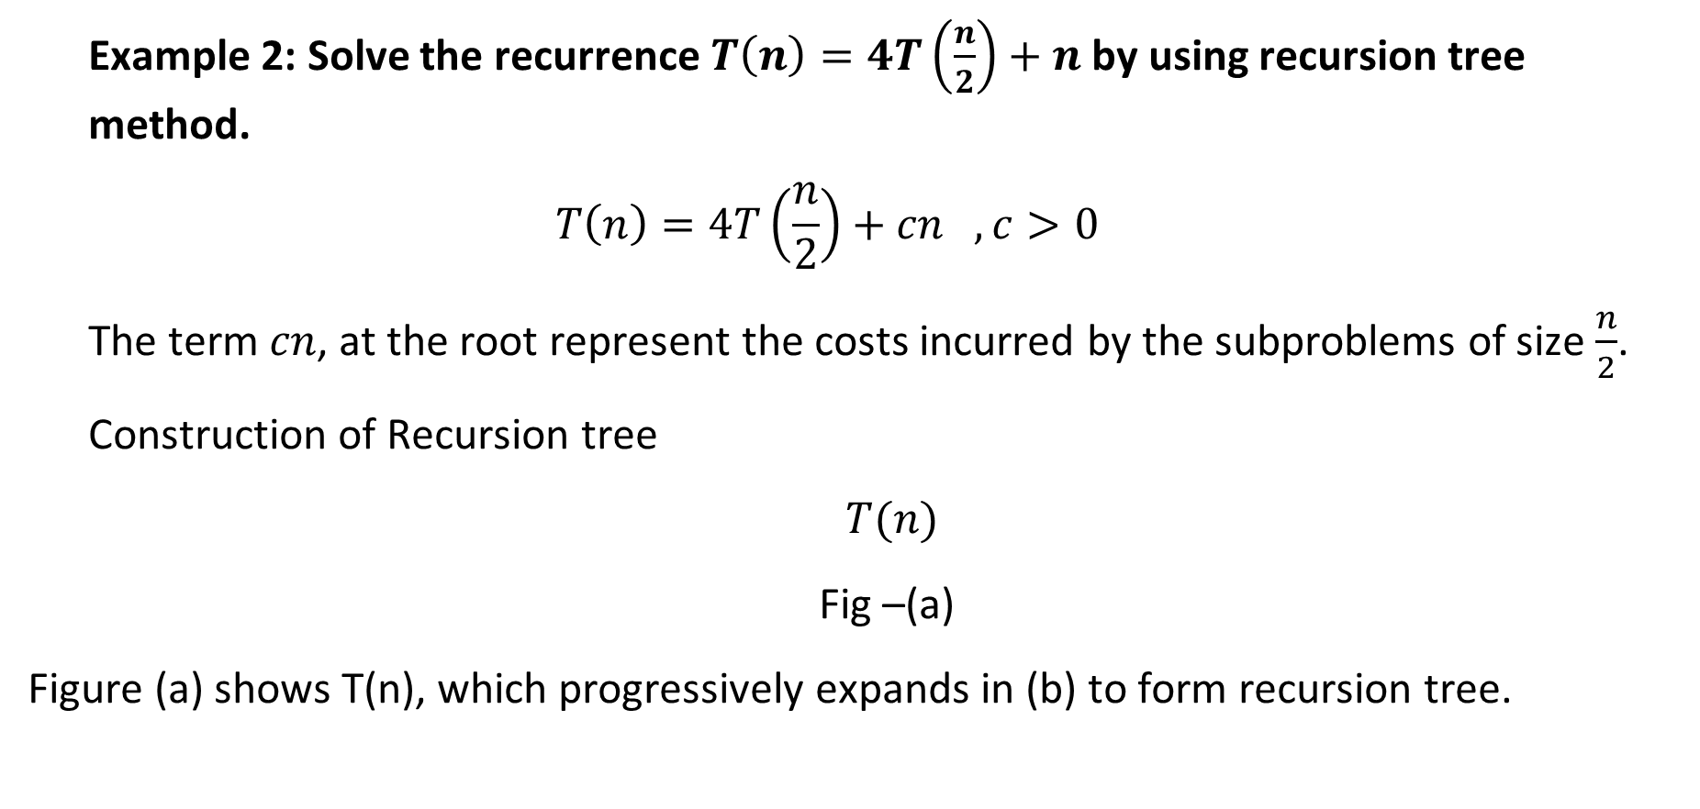
Recursion Tree Method (Example 2)
Example 2: Solve the recurrence $T\left(n\right)=4T\left(\frac{n}{2}\right)+n$ by using recursion tree method.
$$T\left(n\right)=4T\left(\frac{n}{2}\right)+cn , c>0$$
The term $cn$, at the root represent the costs incurred by the subproblems of size $\frac{n}{2}$.
Construction of Recursion tree
$T(n)$
Fig –(a)
Figure (a) shows T(n), which progressively expands in (b) to form recursion tree.

Slide 12










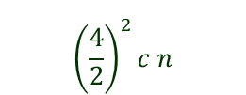


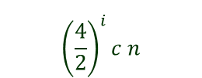






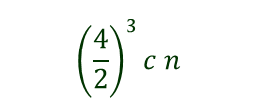









Recursion Tree Method (Example 2)
$$T\left(n\right)=4T\left(\frac{n}{2}\right)+cn , c>0$$
$$cn$$
$$cn$$
$$c\left(\frac{n}{2}\right)$$
$$\frac{4}{2}c n$$
$$c\left(\frac{n}{2}\right)$$
$$c\left(\frac{n}{2}\right)$$
$$c\left(\frac{n}{2}\right)$$
$$\log_{2}{n}$$
$${\left(\frac{4}{2}\right)}^{2}c n$$
$$T\left(\frac{n}{4}\right)$$
$$T\left(\frac{n}{4}\right)$$
$$T\left(\frac{n}{4}\right)$$
$$T\left(\frac{n}{4}\right)$$
$$T\left(\frac{n}{4}\right)$$
$$T\left(\frac{n}{4}\right)$$
$$T\left(\frac{n}{4}\right)$$
$$T\left(\frac{n}{4}\right)$$
$$T\left(\frac{n}{4}\right)$$
$$T\left(\frac{n}{4}\right)$$
$$T\left(\frac{n}{4}\right)$$
$$T\left(\frac{n}{4}\right)$$
$$T\left(\frac{n}{4}\right)$$
$$T\left(\frac{n}{4}\right)$$
$$T\left(\frac{n}{4}\right)$$
$$T\left(\frac{n}{4}\right)$$
$${\left(\frac{4}{2}\right)}^{3}c n$$
$${\left(\frac{4}{2}\right)}^{i}c n$$
$$T\left(1\right) T\left(1\right) T\left(1\right)………………………..T\left(1\right)$$
$${\left(4\right)}^{i}$$
Fig –(b)

Slide 13
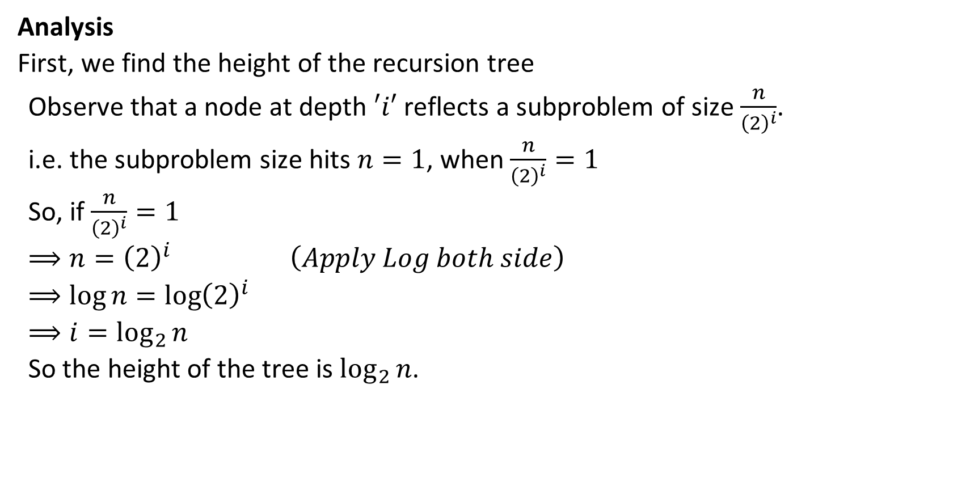
Recursion Tree Method (Example 2)
Analysis
First, we find the height of the recursion tree
Observe that a node at depth $′i′$ reflects a subproblem of size $\frac{n}{{\left(2\right)}^{i}}$.
i.e. the subproblem size hits $n=1$, when $\frac{n}{{\left(2\right)}^{i}}=1$
So, if $\frac{n}{{\left(2\right)}^{i}}=1$
$$⟹n={\left(2\right)}^{i} \left(Apply Log both side\right)$$
$$⟹\log{n=\log{{\left(2\right)}^{i}}}$$
$$⟹i=\log_{2}{n}$$
So the height of the tree is $\log_{2}{n}$.

Slide 14
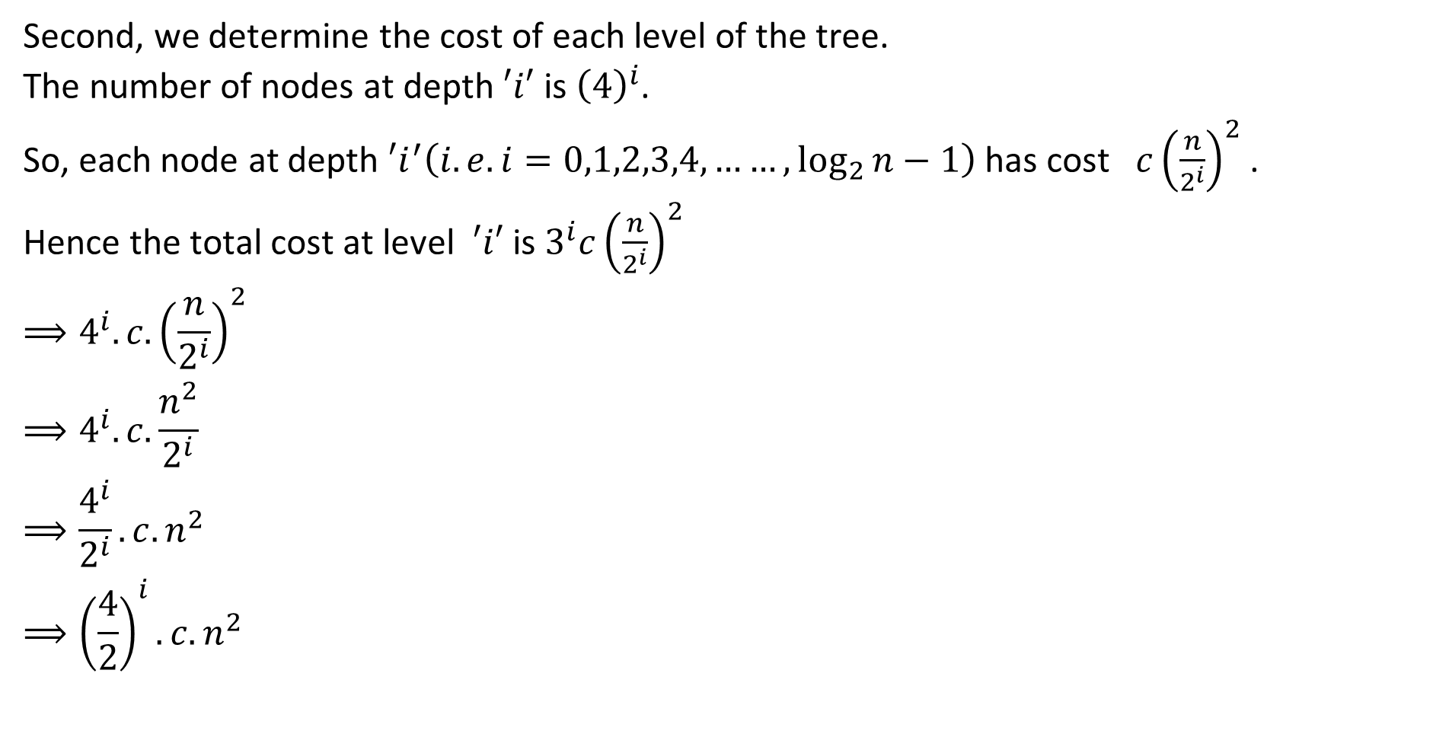
Recursion Tree Method (Example 2)
Second, we determine the cost of each level of the tree.
The number of nodes at depth $′i′$ is ${\left(4\right)}^{i}$.
So, each node at depth $′i^{′}\left(i.e. i=0,1,2,3,4,……, \log_{2}{n}−1\right)$ has cost $c{\left(\frac{n}{2^{i}}\right)}^{2}$ .
Hence the total cost at level $′i′$ is $3^{i}c{\left(\frac{n}{2^{i}}\right)}^{2}$
$$⟹4^{i}. c.{\left(\frac{n}{2^{i}}\right)}^{2}$$
$$⟹4^{i}. c.\frac{n^{2}}{2^{i}}$$
$$⟹\frac{4^{i}}{2^{i}}. c.n^{2}$$
$$⟹{\left(\frac{4}{2}\right)}^{i}.c.n^{2}$$

Slide 15
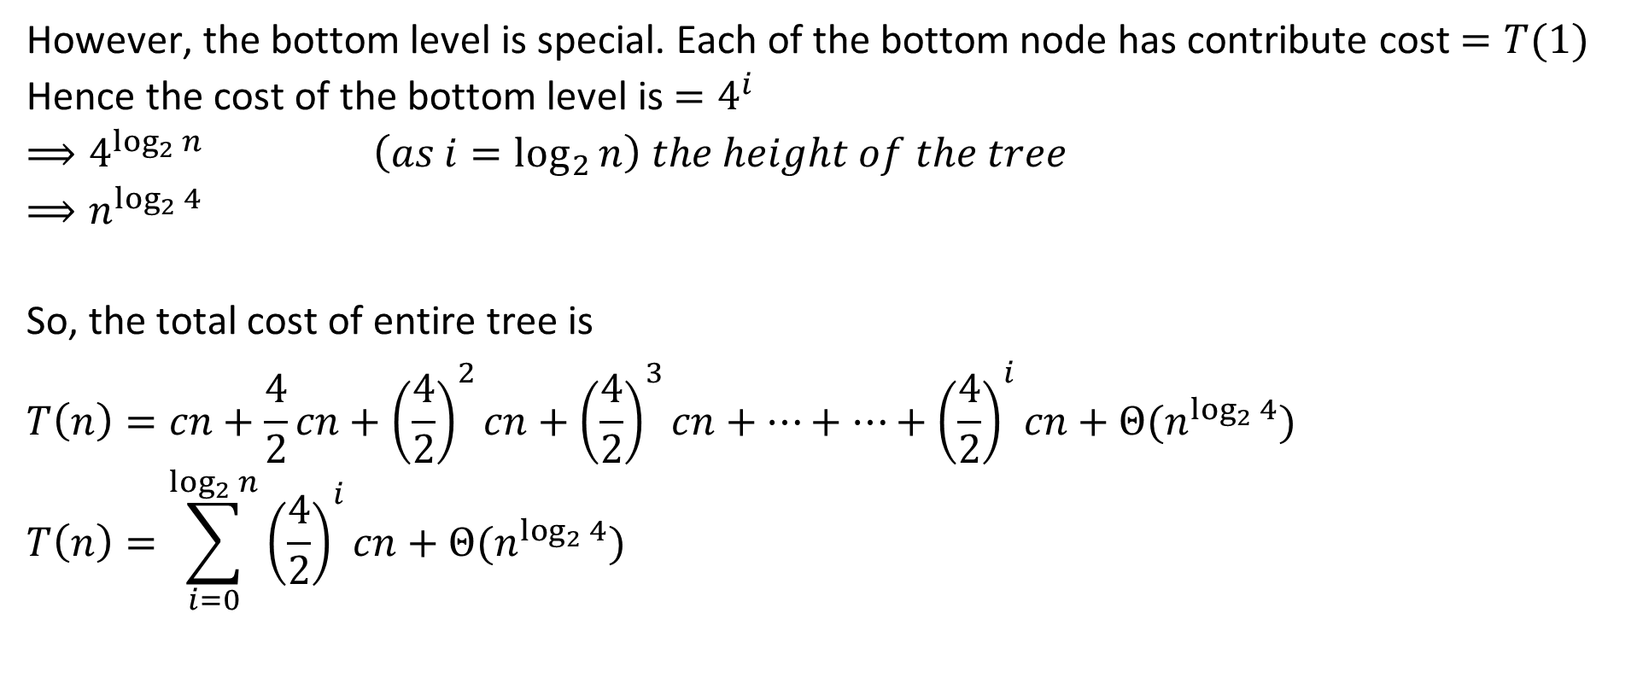
Recursion Tree Method (Example 2)
However, the bottom level is special. Each of the bottom node has contribute cost $=T(1)$
Hence the cost of the bottom level is $=4^{i}$
$$⟹4^{\log_{2}{n}} \left(as i=\log_{2}{n}\right) the height of the tree$$
$$⟹n^{\log_{2}{4}}$$
So, the total cost of entire tree is
$$T\left(n\right)=cn+\frac{4}{2}cn+{\left(\frac{4}{2}\right)}^{2}cn+{\left(\frac{4}{2}\right)}^{3}cn+…+…+{\left(\frac{4}{2}\right)}^{i}cn+Θ(n^{\log_{2}{4}})$$
$$T\left(n\right)=\sum_{i=0}^{\log_{2}{n}}{{\left(\frac{4}{2}\right)}^{i}cn}+Θ(n^{\log_{2}{4}})$$

Slide 16
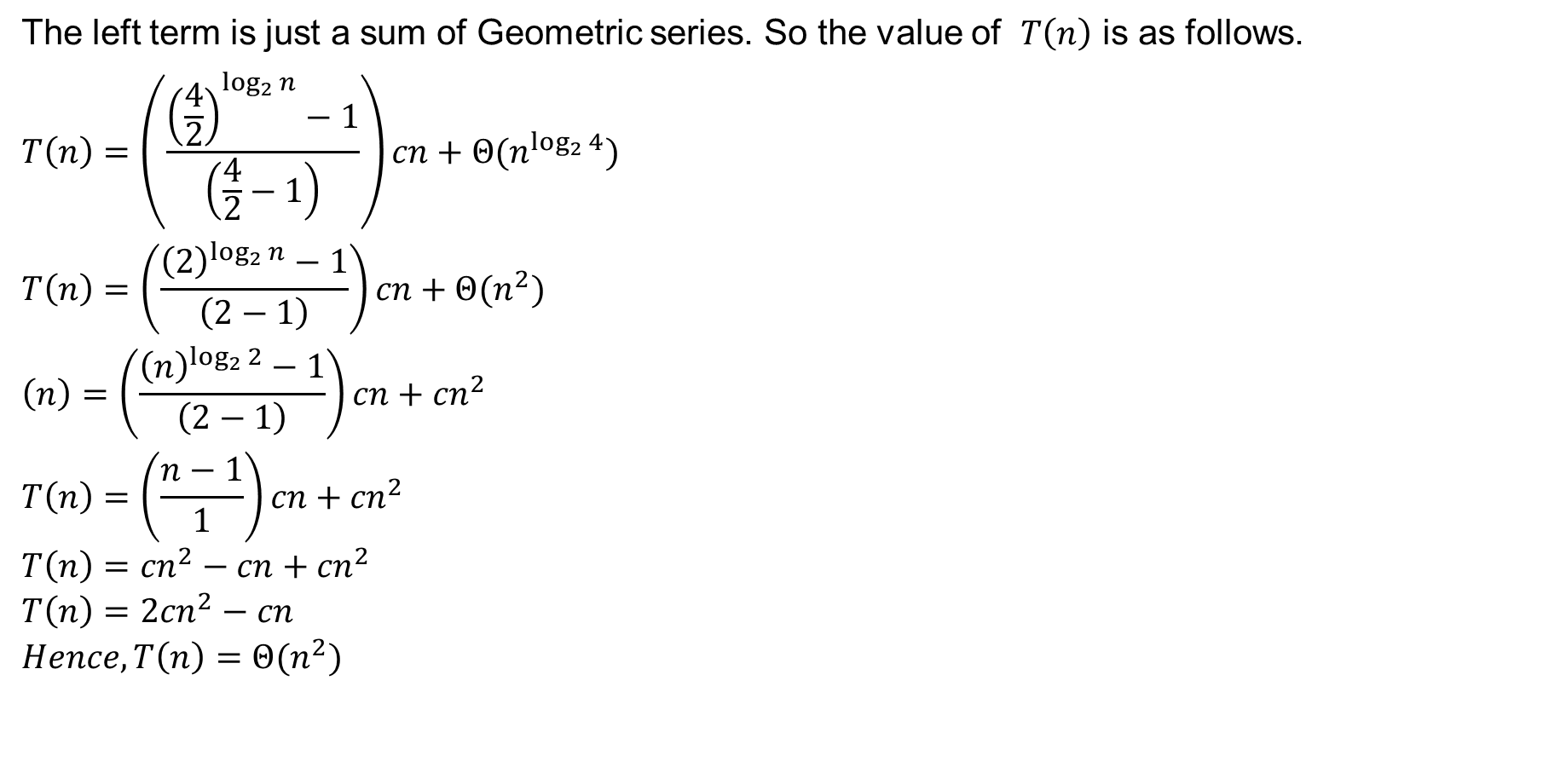
Recursion Tree Method (Example 2)
The left term is just a sum of Geometric series. So the value of $T\left(n\right)$ is as follows.
$$T\left(n\right)=\left(\frac{{\left(\frac{4}{2}\right)}^{\log_{2}{n}}−1}{\left(\frac{4}{2}−1\right)}\right)cn+Θ(n^{\log_{2}{4}})$$
$$T\left(n\right)=\left(\frac{{\left(2\right)}^{\log_{2}{n}}−1}{\left(2−1\right)}\right)cn+Θ(n^{2})$$
$$\left(n\right)=\left(\frac{{\left(n\right)}^{\log_{2}{2}}−1}{\left(2−1\right)}\right)cn+{cn}^{2}$$
$$T\left(n\right)=\left(\frac{n−1}{1}\right)cn+{cn}^{2}$$
$$T\left(n\right)={cn}^{2}−cn+{cn}^{2}$$
$$T\left(n\right)={2cn}^{2}−cn$$
$$Hence,T\left(n\right)=Θ(n^{2})$$

Slide 17
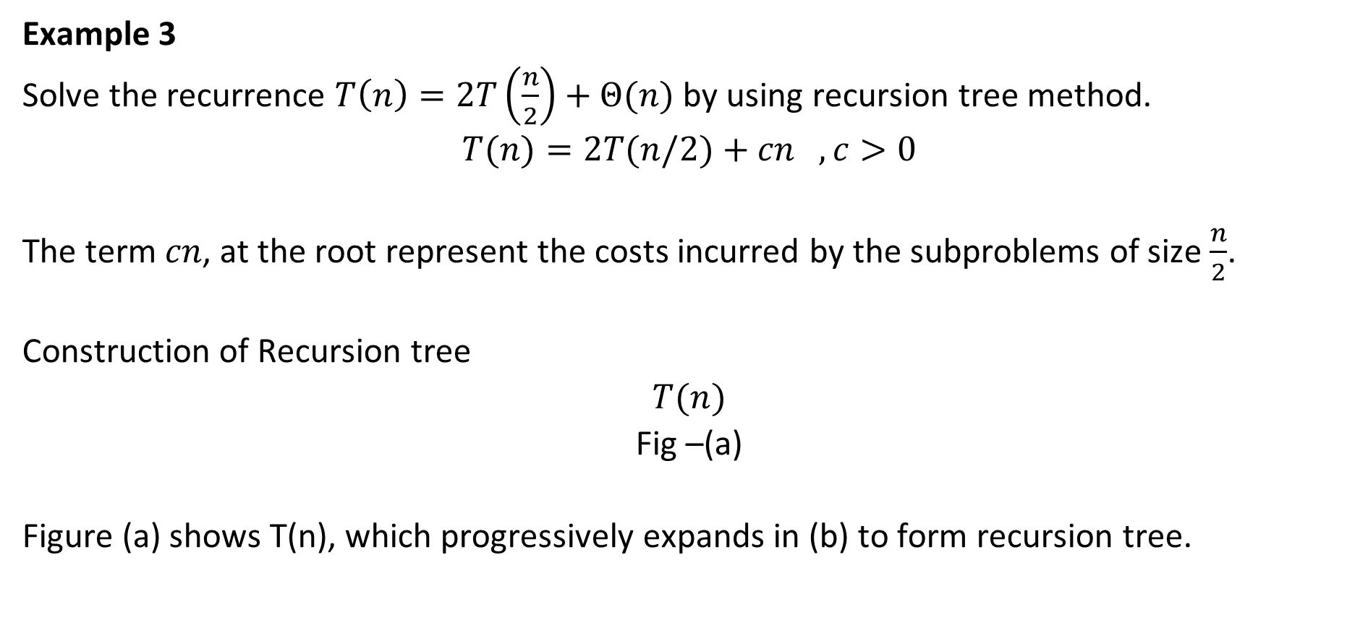
Recursion Tree Method (Example 3)
Example 3
Solve the recurrence $T\left(n\right)=2T\left(\frac{n}{2}\right)+Θ(n)$ by using recursion tree method.
$$T(n)=2T(n/2)+cn , c>0$$
The term $cn$, at the root represent the costs incurred by the subproblems of size $\frac{n}{2}$.
Construction of Recursion tree
$$T(n)$$
Fig –(a)
Figure (a) shows T(n), which progressively expands in (b) to form recursion tree.

Slide 18













Recursion Tree Method (Example 3)
$$T(n)=2T(n/2)+cn , c>0$$
$$cn$$
$$n$$
$$c \left(\frac{n}{2}\right)$$
$$c \left(\frac{n}{2}\right)$$
$$2\frac{n}{2}=n$$
$$\log_{2}{n}$$
$$T\left(\frac{n}{4}\right)$$
$$T\left(\frac{n}{4}\right)$$
$$T\left(\frac{n}{4}\right)$$
$$T\left(\frac{n}{4}\right)$$
$$2^{2}\frac{n}{2^{2}}=n$$
$$2^{i}\frac{n}{2^{i}}=n$$
$$T\left(1\right) T\left(1\right) T\left(1\right)………………………..T\left(1\right)$$
$$2^{i}$$
Fig –(b)

Slide 19
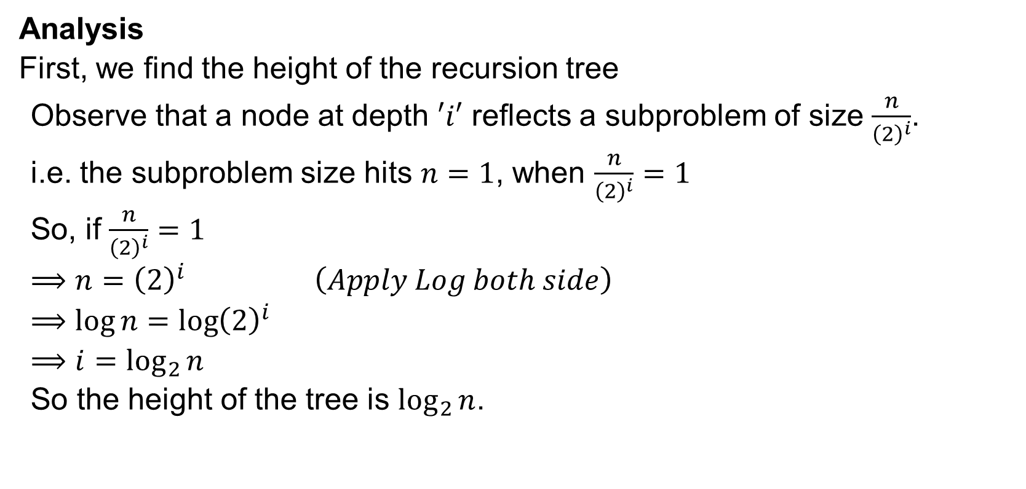
Recursion Tree Method (Example 3)
Analysis
First, we find the height of the recursion tree
Observe that a node at depth $′i′$ reflects a subproblem of size $\frac{n}{{\left(2\right)}^{i}}$.
i.e. the subproblem size hits $n=1$, when $\frac{n}{{\left(2\right)}^{i}}=1$
So, if $\frac{n}{{\left(2\right)}^{i}}=1$
$$⟹n={\left(2\right)}^{i} \left(Apply Log both side\right)$$
$$⟹\log{n=\log{{\left(2\right)}^{i}}}$$
$$⟹i=\log_{2}{n}$$
So the height of the tree is $\log_{2}{n}$.

Slide 20
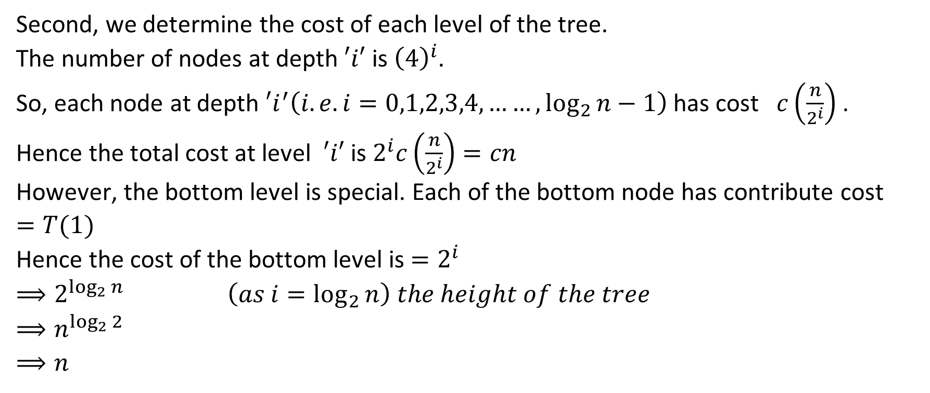
Recursion Tree Method (Example 3)
Second, we determine the cost of each level of the tree.
The number of nodes at depth $′i′$ is ${\left(4\right)}^{i}$.
So, each node at depth $′i^{′}\left(i.e. i=0,1,2,3,4,……, \log_{2}{n}−1\right)$ has cost $c\left(\frac{n}{2^{i}}\right)$ .
Hence the total cost at level $′i′$ is $2^{i}c\left(\frac{n}{2^{i}}\right)=cn$
However, the bottom level is special. Each of the bottom node has contribute cost $=T(1)$
Hence the cost of the bottom level is $=2^{i}$
$$⟹2^{\log_{2}{n}} \left(as i=\log_{2}{n}\right) the height of the tree$$
$$⟹n^{\log_{2}{2}}$$
$$⟹n$$

Slide 21
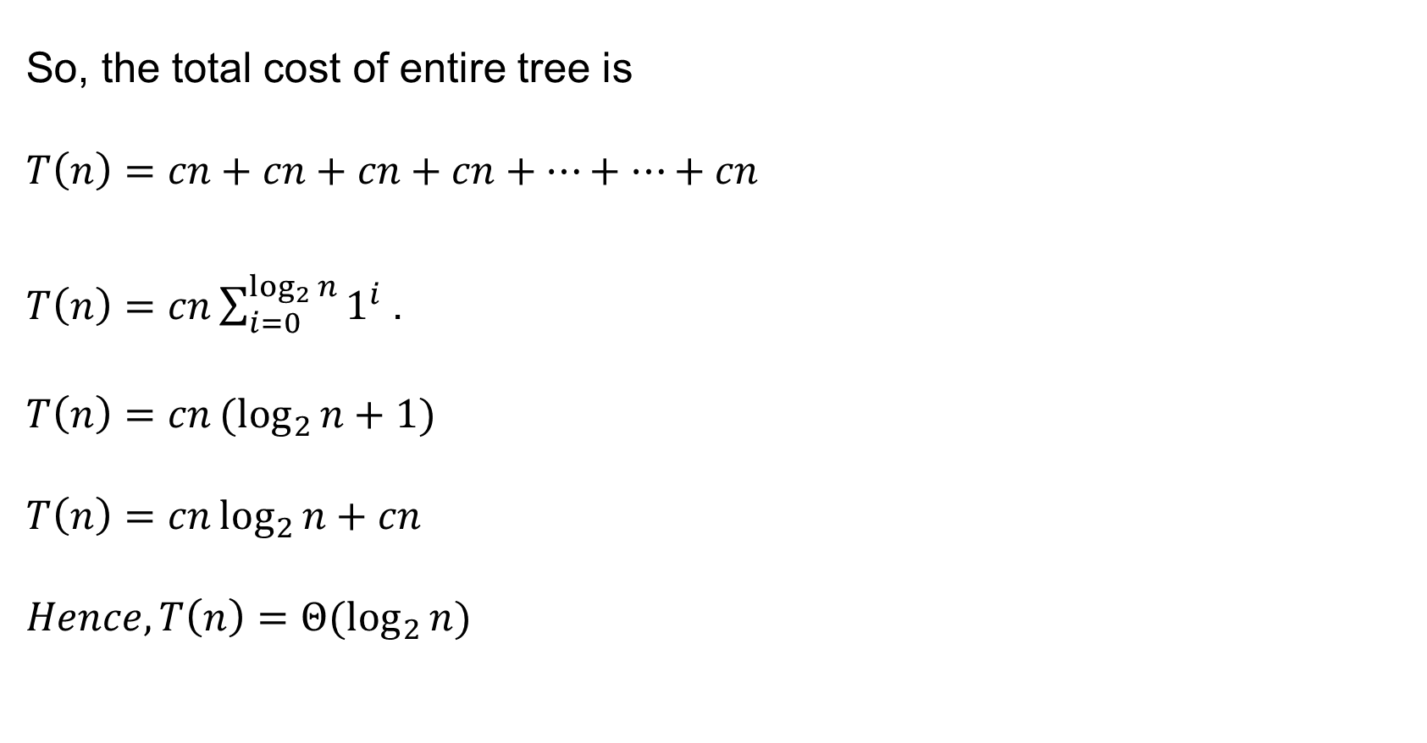
Recursion Tree Method (Example 3)
So, the total cost of entire tree is
$$T\left(n\right)=cn+cn+cn+cn+…+…+cn$$
$T\left(n\right)=cn\sum_{i=0}^{\log_{2}{n}}{1^{i} }$.
$$T\left(n\right)=cn{(log}_{2}{n+1)}$$
$$T\left(n\right)=cn\log_{2}{n+cn}$$
$$Hence,T\left(n\right)=Θ(\log_{2}{n})$$

Slide 22
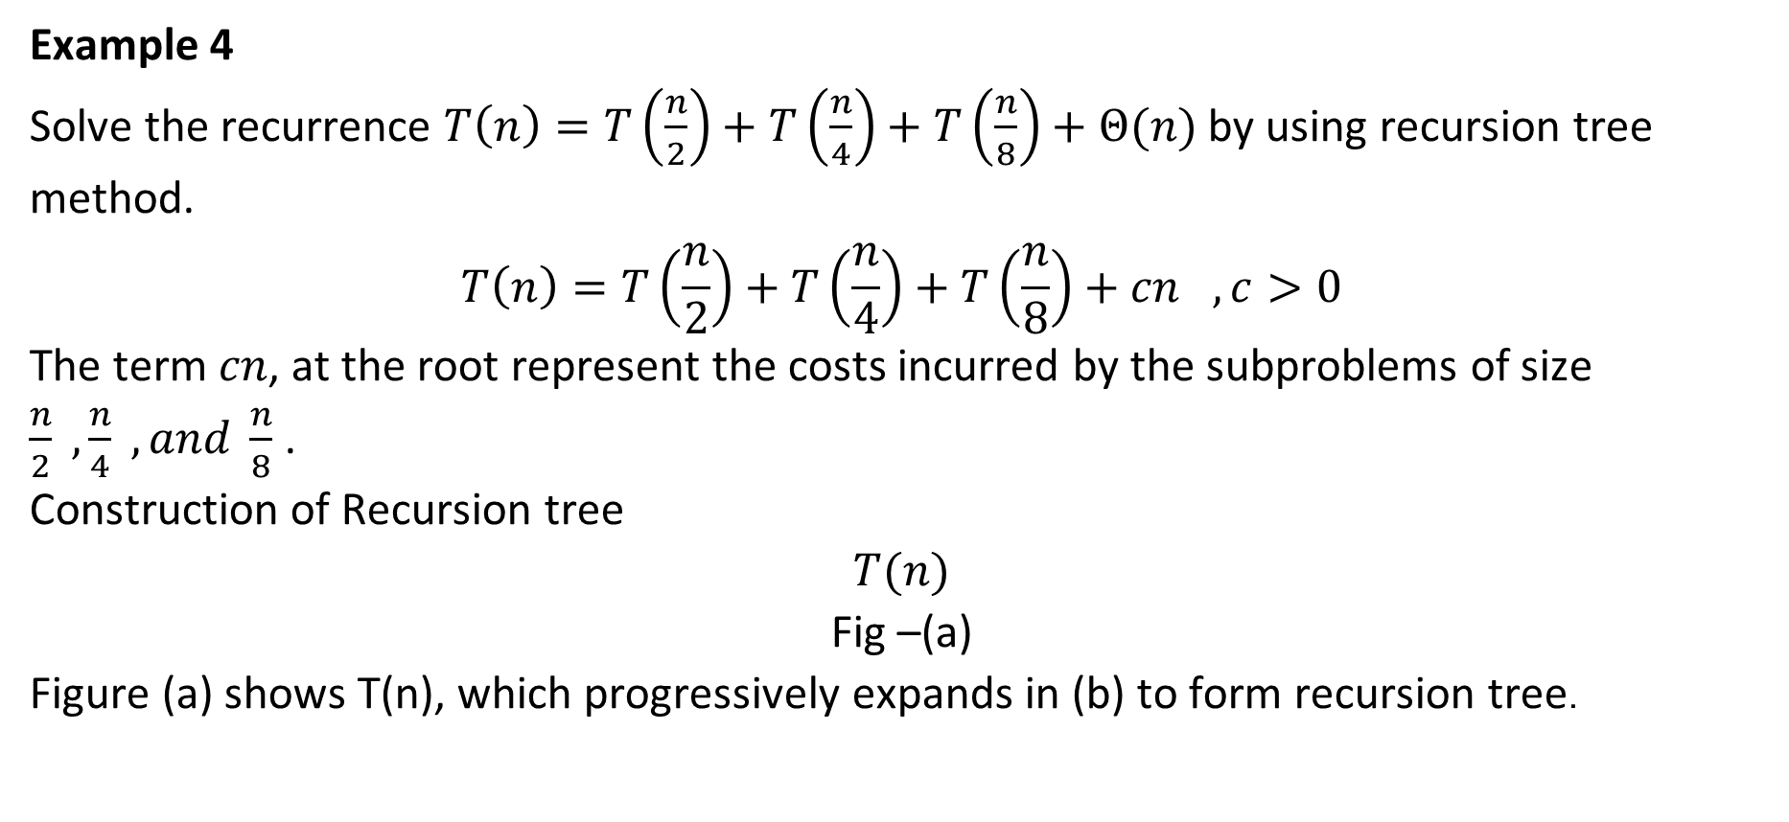
Recursion Tree Method (Example 4)
Example 4
Solve the recurrence $T\left(n\right)=T\left(\frac{n}{2}\right)+T\left(\frac{n}{4}\right)+T\left(\frac{n}{8}\right)+Θ(n)$ by using recursion tree method.
$$T\left(n\right)=T\left(\frac{n}{2}\right)+T\left(\frac{n}{4}\right)+T\left(\frac{n}{8}\right)+cn , c>0$$
The term $cn$, at the root represent the costs incurred by the subproblems of size $\frac{n}{2} ,\frac{n}{4} ,and \frac{n}{8}$.
Construction of Recursion tree
$$T(n)$$
Fig –(a)
Figure (a) shows T(n), which progressively expands in (b) to form recursion tree.

Slide 23










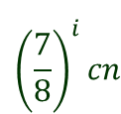





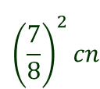




Recursion Tree Method (Example 4)
$$T\left(n\right)=T\left(\frac{n}{2}\right)+T\left(\frac{n}{4}\right)+T\left(\frac{n}{8}\right)+cn , c>0$$
$$cn$$
$$cn$$
$$c\left(\frac{n}{2}\right)$$
$$c\left(\frac{n}{4}\right)$$
$$c\left(\frac{n}{8}\right)$$
$$\frac{7}{8}cn$$
$$\log_{2}{n}$$
$$T\left(\frac{n}{2}\right)$$
$$T\left(\frac{n}{4}\right)$$
$$T\left(\frac{n}{8}\right)$$
$$T\left(\frac{n}{16}\right)$$
$$T\left(\frac{n}{32}\right)$$
$${\left(\frac{7}{8}\right)}^{2}cn$$
$$T\left(\frac{n}{8}\right)$$
$$T\left(\frac{n}{16}\right)$$
$$T\left(\frac{n}{32}\right)$$
$$T\left(\frac{n}{64}\right)$$
$${\left(\frac{7}{8}\right)}^{i}cn$$
$$T\left(1\right) T\left(1\right) T\left(1\right)………………………..T\left(1\right)$$
$$cn$$
Fig –(b)

Slide 24
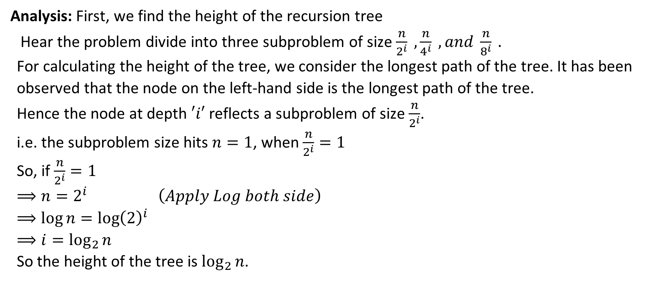
Recursion Tree Method (Example 4)
Analysis: First, we find the height of the recursion tree
Hear the problem divide into three subproblem of size $\frac{n}{2^{i}} , \frac{n}{4^{i}} , and \frac{n}{8^{i}} .$
For calculating the height of the tree, we consider the longest path of the tree. It has been observed that the node on the left-hand side is the longest path of the tree.
Hence the node at depth $′i′$ reflects a subproblem of size $\frac{n}{2^{i}}$.
i.e. the subproblem size hits $n=1$, when $\frac{n}{2^{i}}=1$
So, if $\frac{n}{2^{i}}=1$
$$⟹n=2^{i} \left(Apply Log both side\right)$$
$$⟹\log{n=\log{{\left(2\right)}^{i}}}$$
$$⟹i=\log_{2}{n}$$
So the height of the tree is $\log_{2}{n}$.

Slide 25
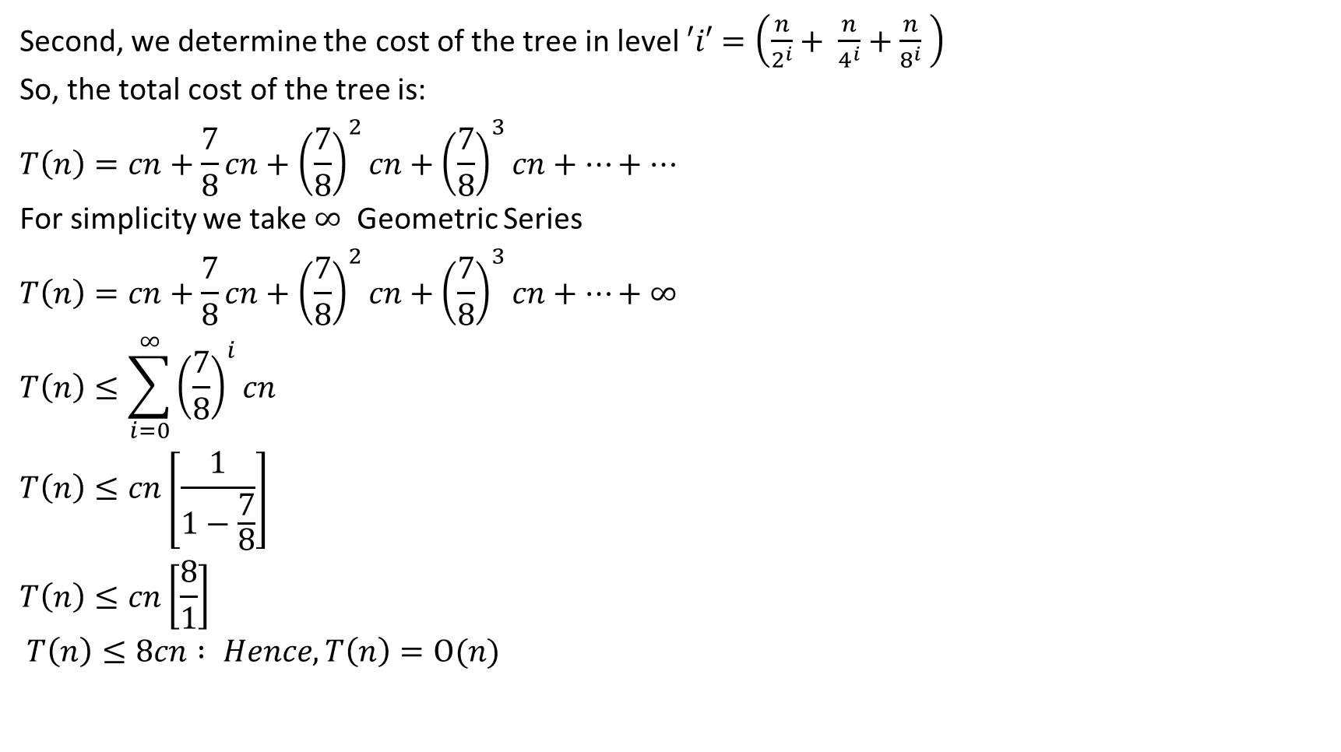
Recursion Tree Method (Example 4)
Second, we determine the cost of the tree in level $′i′$ $=\left(\frac{n}{2^{i}}+ \frac{n}{4^{i}}+\frac{n}{8^{i}} \right)$
So, the total cost of the tree is:
$$T\left(n\right)=cn+\frac{7}{8}cn+{\left(\frac{7}{8}\right)}^{2}cn+{\left(\frac{7}{8}\right)}^{3}cn+…+…$$
For simplicity we take $∞$ Geometric Series
$$T\left(n\right)=cn+\frac{7}{8}cn+{\left(\frac{7}{8}\right)}^{2}cn+{\left(\frac{7}{8}\right)}^{3}cn+…+∞$$
$$T\left(n\right)≤\sum_{i=0}^{∞}{{\left(\frac{7}{8}\right)}^{i}cn}$$
$$T\left(n\right)≤cn\left[\frac{1}{1−\frac{7}{8}}\right]$$
$$T\left(n\right)≤cn\left[\frac{8}{1}\right]$$
$T\left(n\right)≤8cn : Hence,T\left(n\right)=Ο(n)$

Slide 26
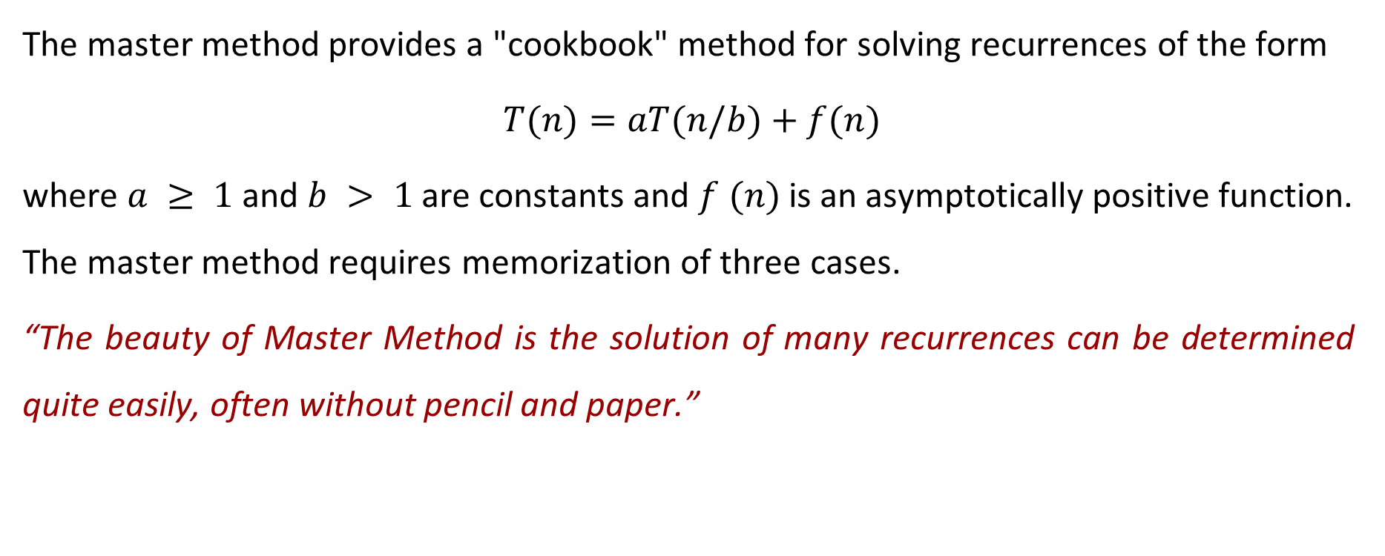
Master Method
The master method provides a "cookbook" method for solving recurrences of the form
$T(n)=aT(n/b)+f(n)$
where $a ≥ 1$ and $b > 1$ are constants and $f (n)$ is an asymptotically positive function. The master method requires memorization of three cases.
“The beauty of Master Method is the solution of many recurrences can be determined quite easily, often without pencil and paper.”

Slide 27
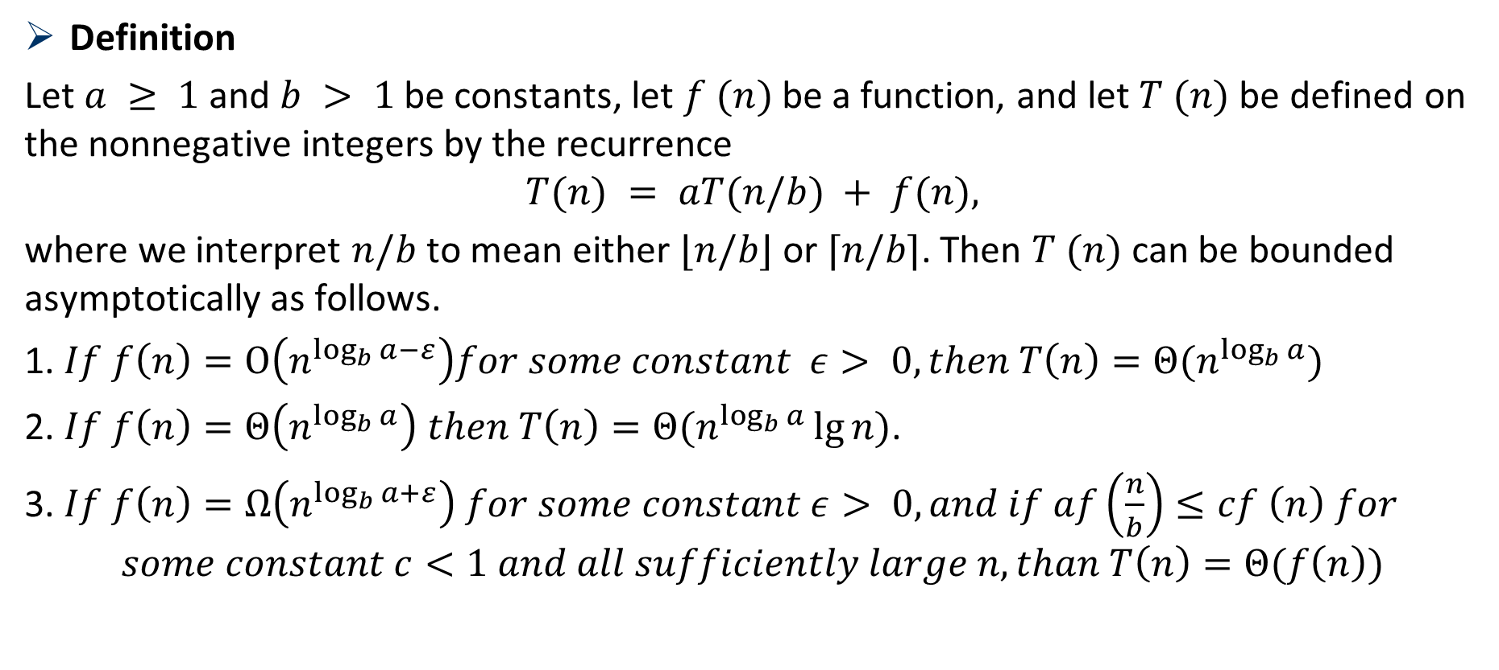
Master Method
Definition
Let $a ≥ 1$and $b > 1$be constants, let $f (n)$ be a function, and let $T (n)$ be defined on the nonnegative integers by the recurrence
$$T(n) = aT(n/b) + f(n),$$
where we interpret $n/b$ to mean either $⌊n/b⌋$or $⌈n/b⌉$. Then $T (n)$ can be bounded asymptotically as follows.
1. $If f\left(n\right)=Ο\left(n^{\log_{b}{a−}ε}\right)for some constant ε> 0, then T\left(n\right)=Θ(n^{\log_{b}{a}})$
2. $If f\left(n\right)=Θ\left(n^{\log_{b}{a}}\right) then T\left(n\right)=Θ(n^{\log_{b}{a}}\lg{n)}$.
3. $If f\left(n\right)=Ω\left(n^{\log_{b}{a+}ε}\right) for some constant ε> 0, and if af\left(\frac{n}{b}\right)≤cf \left(n\right) for$
$$some constant c<1 and all sufficiently large n, than T\left(n\right)=Θ(f\left(n\right))$$

Slide 28
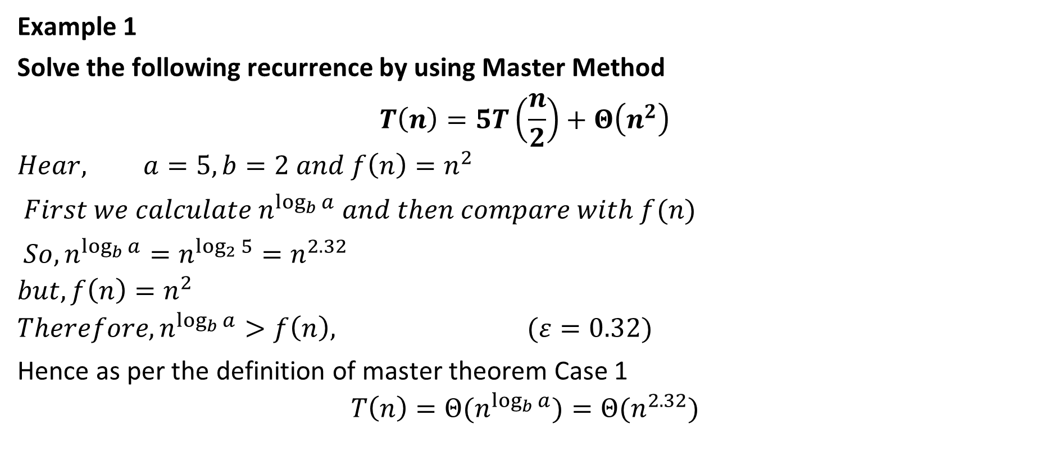
Master Method
Example 1
Solve the following recurrence by using Master Method
$$T\left(n\right)=5T\left(\frac{n}{2}\right)+Θ\left(n^{2}\right)$$
$$Hear, a=5, b=2 and f\left(n\right)=n^{2}$$
$First we calculate n^{\log_{b}{a}} and then compare with f(n)$
$So, n^{\log_{b}{a}}=n^{\log_{2}{5}}=n^{2.32}$
$$but, f\left(n\right)=n^{2}$$
$$Therefore, n^{\log_{b}{a}}>f\left(n\right), (ε=0.32)$$
Hence as per the definition of master theorem Case 1
$$T\left(n\right)={Θ(n}^{\log_{b}{a}})={Θ(n}^{2.32})$$

Slide 29
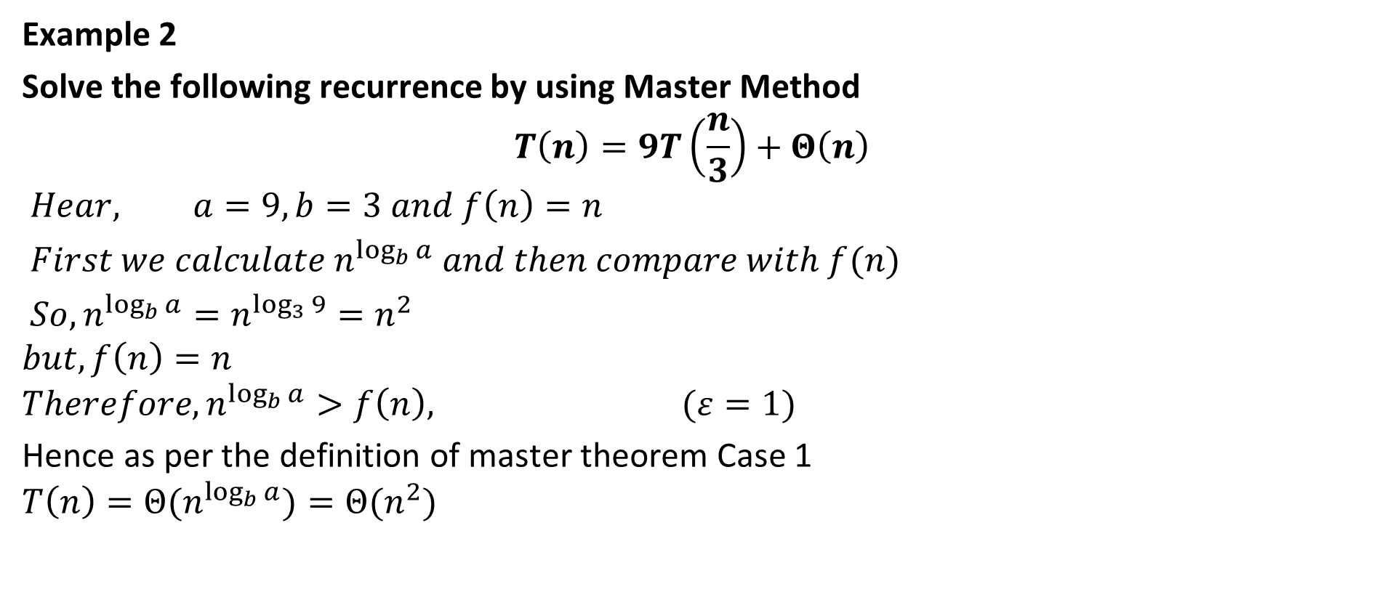
Master Method
Example 2
Solve the following recurrence by using Master Method
$$T\left(n\right)=9T\left(\frac{n}{3}\right)+Θ\left(n\right)$$
$$Hear, a=9, b=3 and f\left(n\right)=n$$
$First we calculate n^{\log_{b}{a}} and then compare with f(n)$
$So, n^{\log_{b}{a}}=n^{\log_{3}{9}}=n^{2}$
$$but, f\left(n\right)=n$$
$$Therefore, n^{\log_{b}{a}}>f\left(n\right), (ε=1)$$
Hence as per the definition of master theorem Case 1
$$T\left(n\right)={Θ(n}^{\log_{b}{a}})={Θ(n}^{2})$$

Slide 30
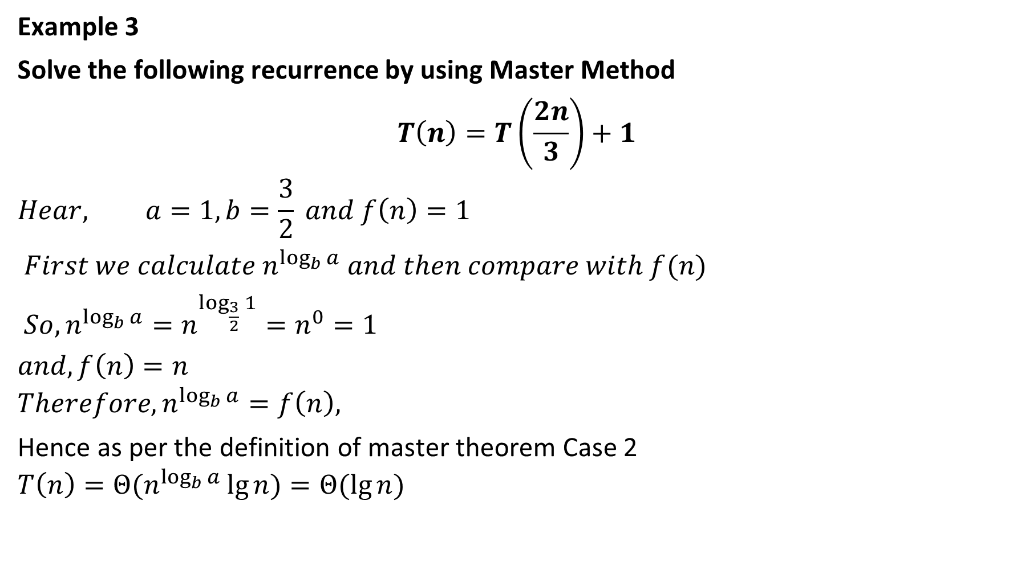
Master Method
Example 3
Solve the following recurrence by using Master Method
$$T\left(n\right)=T\left(\frac{2n}{3}\right)+1$$
$$Hear, a=1, b=\frac{3}{2} and f\left(n\right)=1$$
$First we calculate n^{\log_{b}{a}} and then compare with f(n)$
$So, n^{\log_{b}{a}}=n^{\log_{\frac{3}{2}}{1}}=n^{0}=1$
$$and, f\left(n\right)=n$$
$$Therefore, n^{\log_{b}{a}}=f\left(n\right),$$
Hence as per the definition of master theorem Case 2
$$T\left(n\right)={Θ(n}^{\log_{b}{a}}\lg{n})=Θ(\lg{n})$$

Slide 31
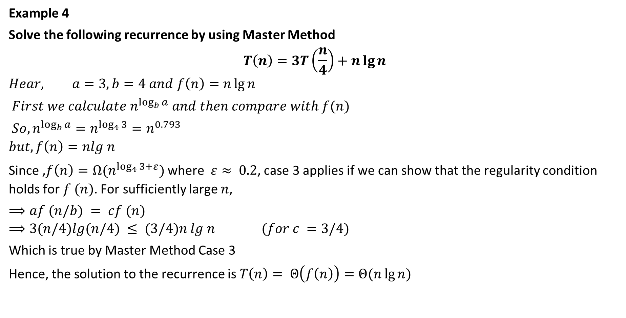
Master Method
Example 4
Solve the following recurrence by using Master Method
$$T\left(n\right)=3T\left(\frac{n}{4}\right)+n\lg{n}$$
$$Hear, a=3, b=4 and f\left(n\right)=n\lg{n}$$
$First we calculate n^{\log_{b}{a}} and then compare with f(n)$
$So, n^{\log_{b}{a}}=n^{\log_{4}{3}}=n^{0.793}$
$$but, f\left(n\right)=nlg n$$
Since ,$f\left(n\right)=Ω(n^{\log_{4}{3+ε}})$ where $­ ε≈ 0.2$, case 3 applies if we can show that the regularity condition holds for $f (n)$. For sufficiently large $n$,
$⟹af (n/b) = cf (n)$
$$⟹3(n/4)lg(n/4) ≤ (3/4)n lg n (for c =3/4)$$
Which is true by Master Method Case 3
Hence, the solution to the recurrence is $T\left(n\right)= Θ\left(f\left(n\right)\right)=Θ(n\lg{n)}$

Slide 32
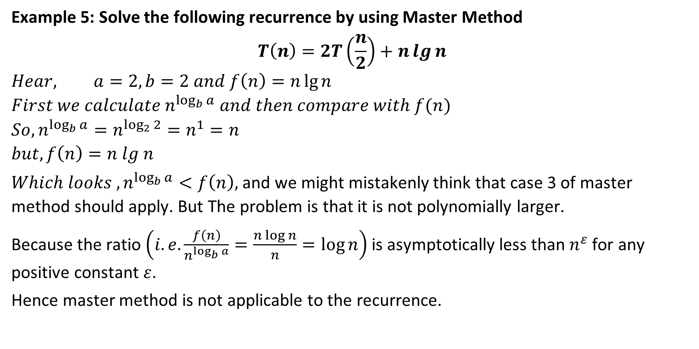
Master Method
Example 5: Solve the following recurrence by using Master Method
$$T\left(n\right)=2T\left(\frac{n}{2}\right)+n\lg{n}$$
$$Hear, a=2, b=2 and f\left(n\right)=n\lg{n}$$
$$First we calculate n^{\log_{b}{a}} and then compare with f(n)$$
$$So, n^{\log_{b}{a}}=n^{\log_{2}{2}}=n^{1}=n$$
$$but, f\left(n\right)=n lg n$$
$Which looks , n^{\log_{b}{a}}<f\left(n\right),$ and we might mistakenly think that case 3 of master method should apply. But The problem is that it is not polynomially larger.
Because the ratio $\left(i.e. \frac{f\left(n\right)}{n^{\log_{b}{a}}}=\frac{n\log{n}}{n}=\log{n}\right)$ is asymptotically less than $n^{ε}$ for any positive constant $ε$.
Hence master method is not applicable to the recurrence.

Slide 33
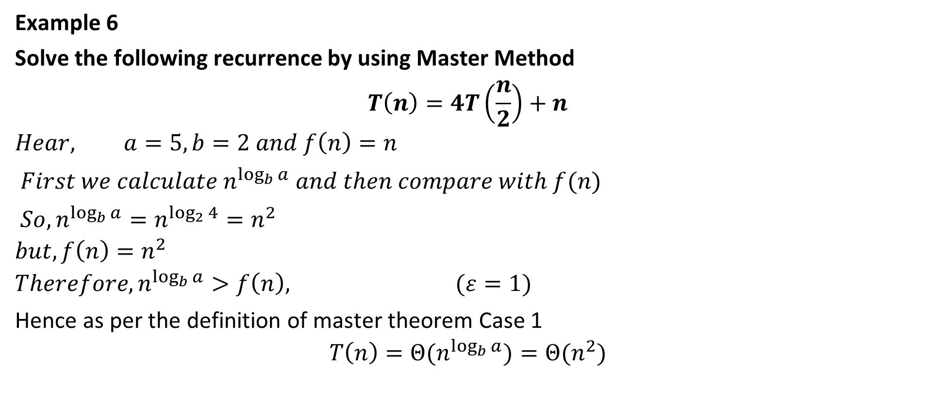
Master Method
Example 6
Solve the following recurrence by using Master Method
$$T\left(n\right)=4T\left(\frac{n}{2}\right)+n$$
$$Hear, a=5, b=2 and f\left(n\right)=n$$
$First we calculate n^{\log_{b}{a}} and then compare with f(n)$
$So, n^{\log_{b}{a}}=n^{\log_{2}{4}}=n^{2}$
$$but, f\left(n\right)=n^{2}$$
$$Therefore, n^{\log_{b}{a}}>f\left(n\right), (ε=1)$$
Hence as per the definition of master theorem Case 1
$$T\left(n\right)={Θ(n}^{\log_{b}{a}})={Θ(n}^{2})$$

Slide 34
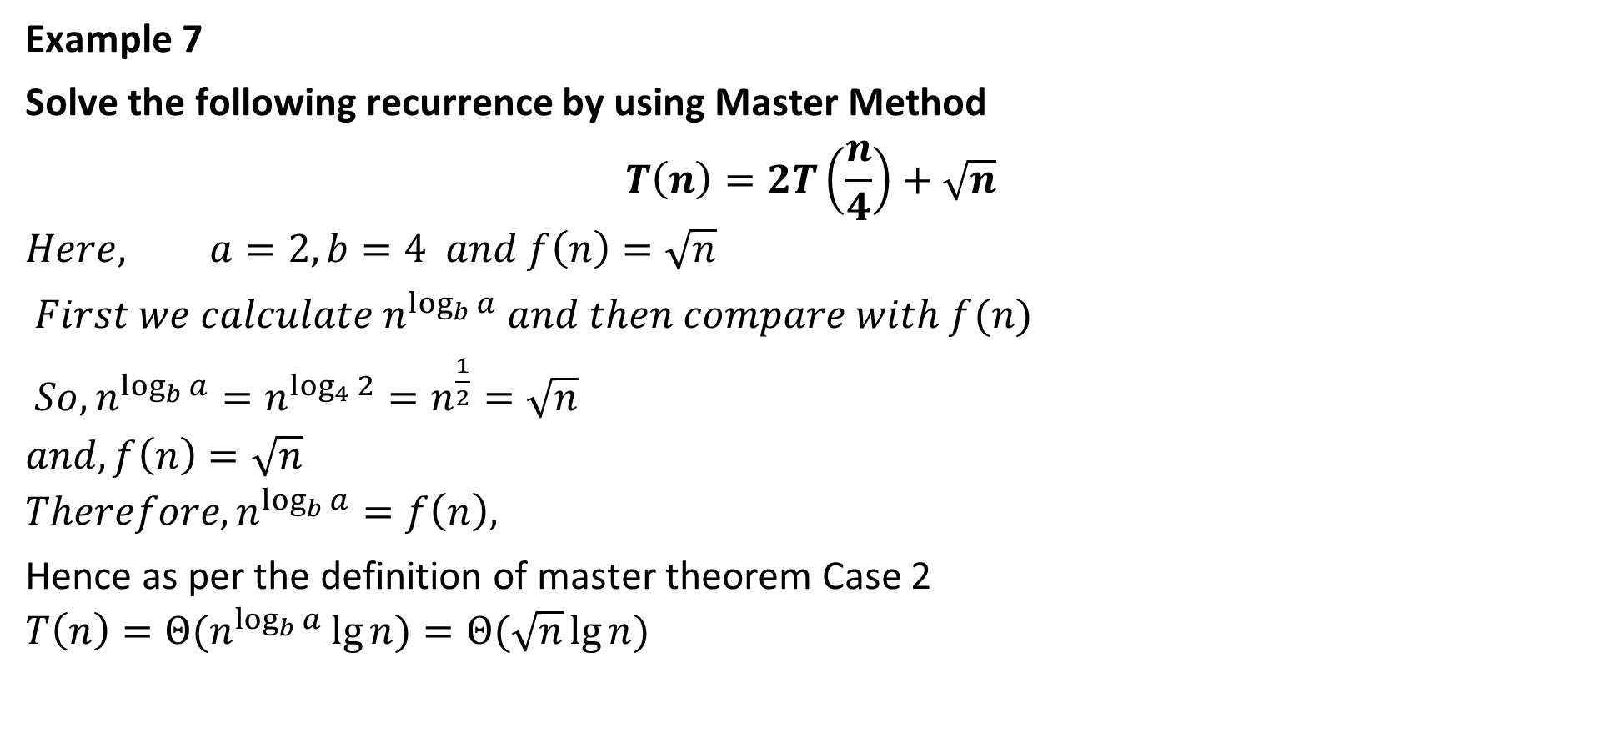
Master Method
Example 7
Solve the following recurrence by using Master Method
$$T\left(n\right)=2T\left(\frac{n}{4}\right)+\sqrt{n}$$
$$Here, a=2, b=4 and f\left(n\right)=\sqrt{n}$$
$First we calculate n^{\log_{b}{a}} and then compare with f(n)$
$So, n^{\log_{b}{a}}=n^{\log_{4}{2}}=n^{\frac{1}{2}}=\sqrt{n}$
$$and, f\left(n\right)=\sqrt{n}$$
$$Therefore, n^{\log_{b}{a}}=f\left(n\right),$$
Hence as per the definition of master theorem Case 2
$$T\left(n\right)={Θ(n}^{\log_{b}{a}}\lg{n})=Θ(\sqrt{n}\lg{n})$$

Slide 35
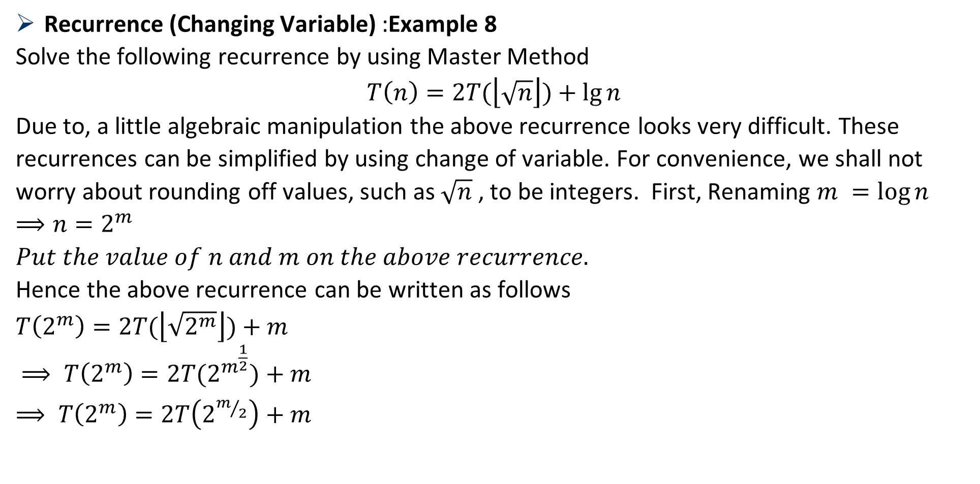
Master Method
Recurrence (Changing Variable) :Example 8
Solve the following recurrence by using Master Method
$$T\left(n\right)=2T(\left\lfloor \sqrt{n}\right\rfloor )+\lg{n}$$
Due to, a little algebraic manipulation the above recurrence looks very difficult. These recurrences can be simplified by using change of variable. For convenience, we shall not worry about rounding off values, such as $\sqrt{n}$ , to be integers. First, Renaming $m =\log{n}$
$$⟹n=2^{m}$$
$Put the value of n and m on the above recurrence.$
Hence the above recurrence can be written as follows
$$T\left(2^{m}\right)=2T(\left\lfloor \sqrt{2^{m}}\right\rfloor )+m$$
$⟹ T\left(2^{m}\right)=2T(2^{m^{\frac{1}{2}}})+m$
$⟹ T\left(2^{m}\right)=2T\left(2^{m/2}\right)+m$

Slide 36
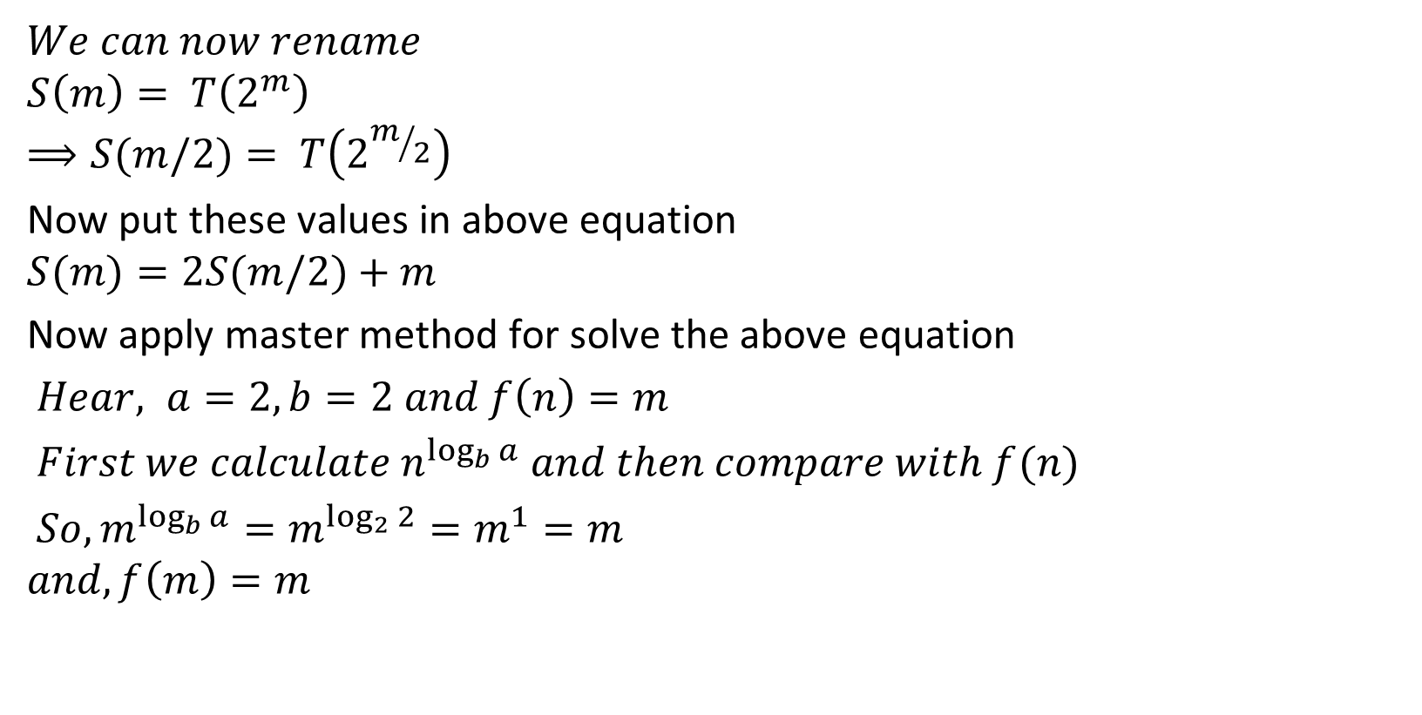
Master Method
$$We can now rename$$
$$S\left(m\right)= T\left(2^{m}\right)$$
$$⟹S(m/2)= T\left(2^{m/2}\right)$$
Now put these values in above equation
$$S(m)=2S(m/2)+m$$
Now apply master method for solve the above equation
$Hear, a=2, b=2 and f\left(n\right)=m$
$First we calculate n^{\log_{b}{a}} and then compare with f(n)$
$So, m^{\log_{b}{a}}=m^{\log_{2}{2}}=m^{1}=m$
$$and, f\left(m\right)=m$$

Slide 37

Master Method
Hence as per the definition of master theorem Case 2
$$S\left(m\right)={Θ(m}^{\log_{b}{a}}\lg{m})$$
$$⟹S(m)=Θ(m\lg{m})$$
$$⟹S(m)=Θ(m\lg{m})$$
$$⟹T\left(2^{m}\right)=Θ\left(m\lg{m}\right) as S\left(m\right)= T\left(2^{m}\right)$$
$$⟹T\left(n\right)=Θ\left(\log{n}\lg{\log{n}}\right) as n=2^{m}, and m=\log{n}$$
Hence the complexity of above recurrence is $Θ\left(\log{n}\lg{\log{n}}\right)$

Slide 38

Master Method
Example 9
Solve the following recurrence by using Master Method
$$T\left(n\right)=2T(\left\lfloor \sqrt{n}\right\rfloor )+1$$
Due to, a little algebraic manipulation the above recurrence looks very difficult. These recurrences can be simplified by using change of variable. For convenience, we shall not worry about rounding off values, such as $\sqrt{n}$ , to be integers.
First, Renaming $m =\log{n}$
$$⟹n=2^{m}$$
$$⟹n^{1/2}=2^{m⁄2}$$
$Put the value of n on the above recurrence.$
Hence the above recurrence can be written as follows
$$T\left(2^{m}\right)=2T(\left\lfloor \sqrt{2^{m}}\right\rfloor )+1$$
$⟹ T\left(2^{m}\right)=2T(2^{m^{1/2}})+1$
$⟹ T\left(2^{m}\right)=2T\left(2^{m/2}\right)+1$

Slide 39

Master Method
$$We can now rename$$
$$S\left(m\right)= T\left(2^{m}\right)$$
$$⟹S(m/2)= T\left(2^{m/2}\right)$$
Now put these values in above equation
$$S(m)=2S(m/2)+1$$
Now apply master method for solve the above equation
$Hear, a=2, b=2 and f\left(n\right)=m$
$First we calculate n^{\log_{b}{a}} and then compare with f(n)$
$So, m^{\log_{b}{a}}=m^{\log_{2}{2}}=m^{1}=m$ $and, f\left(m\right)=m$
Hence as per the definition of master theorem Case 1:
$m^{\log_{b}{a}}>f\left(m\right)$
$⇒m>1$
$$⇒m^{1−ε}=1 where ε=1$$

Slide 40

Master Method
Hence, $S\left(m\right)={Θ(m}^{\log_{b}{a}})$
$$⟹S\left(m\right)={Θ(m}^{\log_{b}{a}})=Θ(m)$$
$$⟹S\left(m\right)=Θ\left(m\right)$$
$$⟹T\left(2^{m}\right)=Θ\left(\log{n}\right) as S\left(m\right)= T\left(2^{m}\right) and m=\log{n}$$
$$⟹T\left(n\right)=Θ\left(\log{n}\right) as n=2^{m}$$
Hence the complexity of above recurrence is $Θ\left(\log{n}\right)$

Slide 41

Thank U

